Slide 1


Mobile and Cloud Centric Internet of Things
Satish Srirama
satish.srirama@ut.ee
Guest Lecture at IIT Hyderabad
17th – 18th August 2017
Notes:
Ome Srirama Jai Vinayaka
Ome Srirama Jai Vinayaka

Slide 2

Who am I
Head of Mobile & Cloud Lab, Institute of Computer Science, University of Tartu, Estonia
http://mc.cs.ut.ee
Notes:
Volume 46
Editors
IoT is one of the key focus areas of SPE

Slide 3
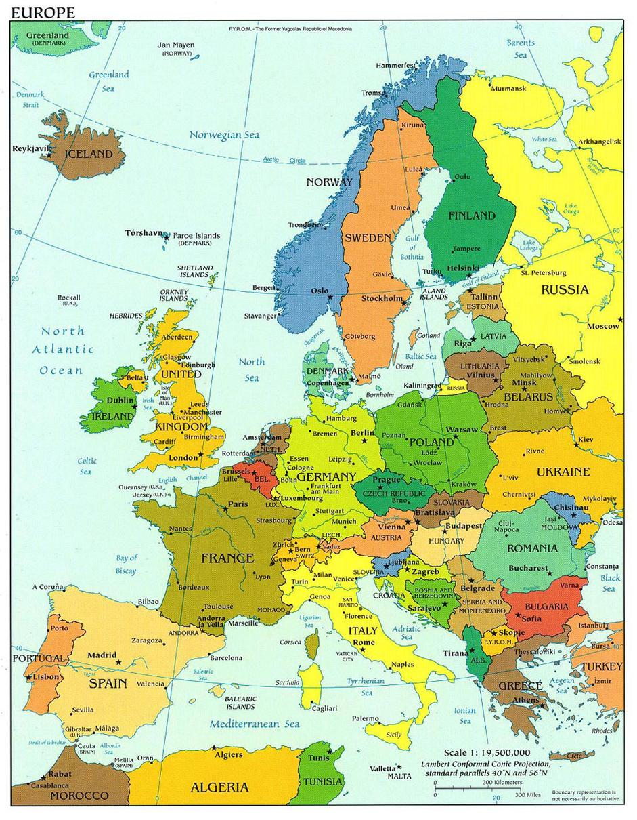
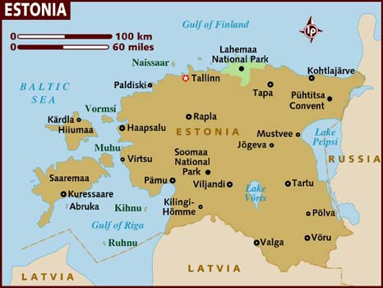
Estonia pop: 1,300,000
TARTU
Pop: 100,000

Slide 4
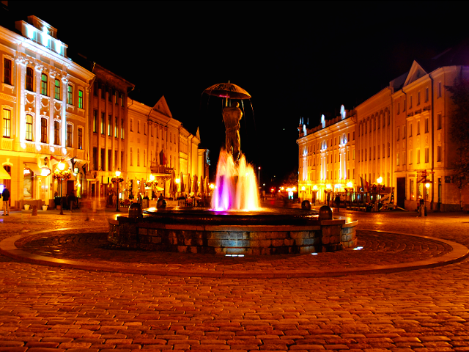
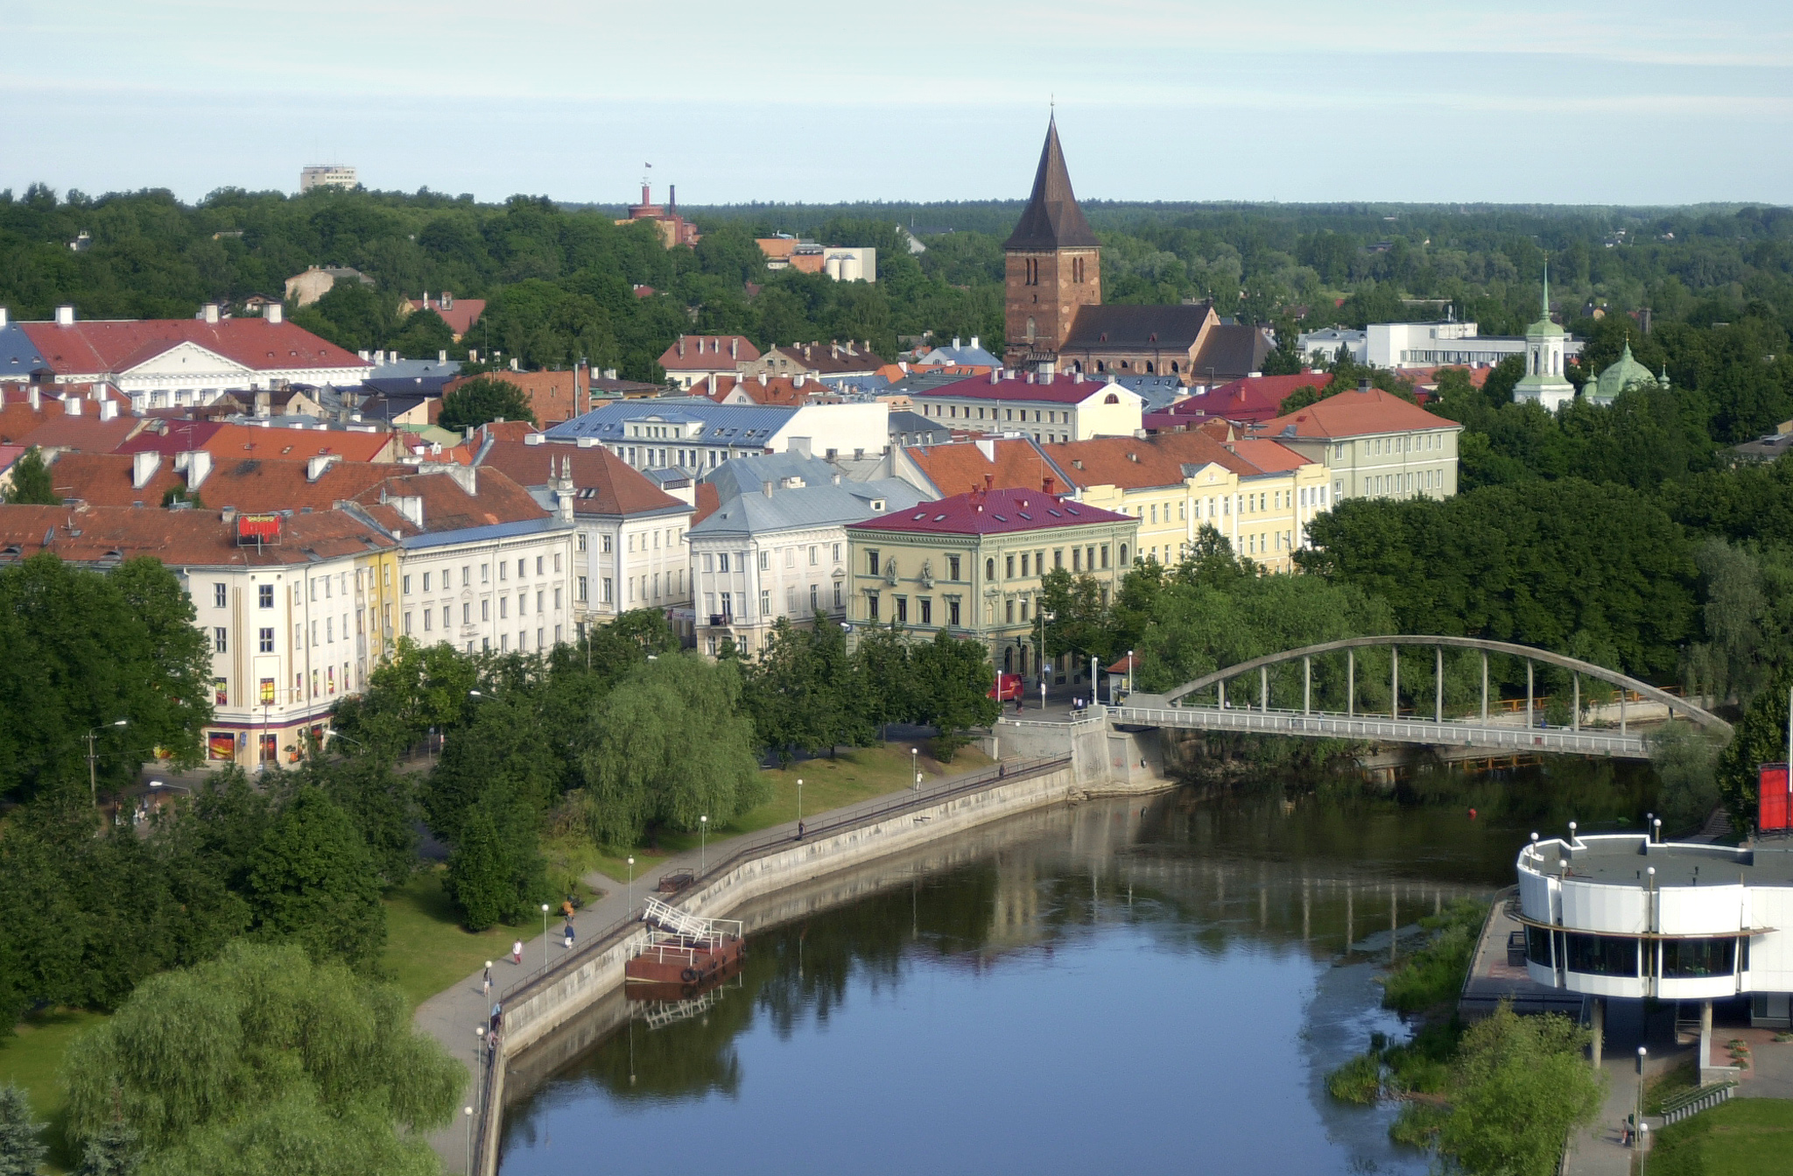
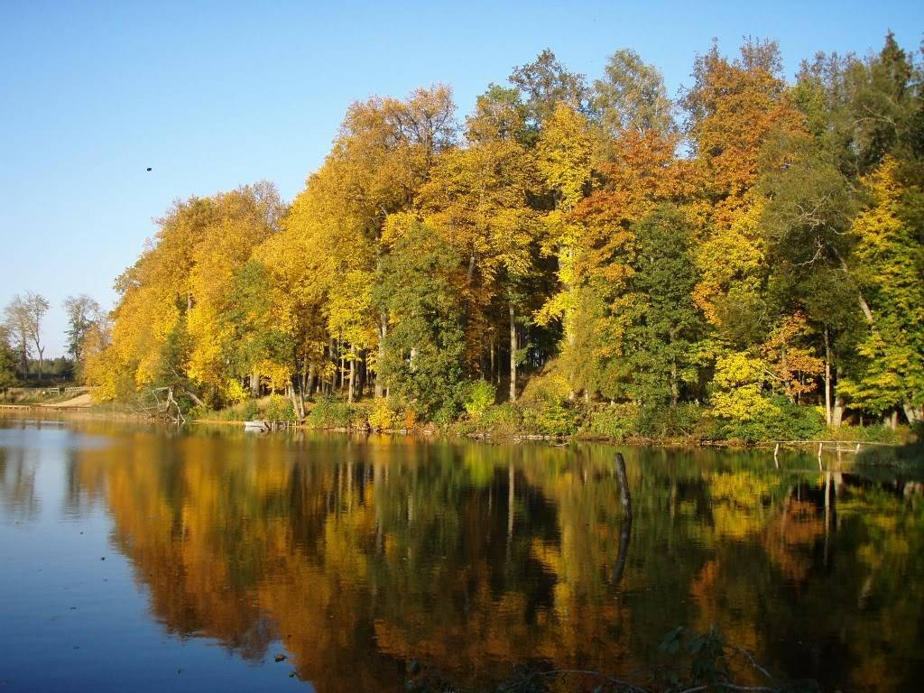
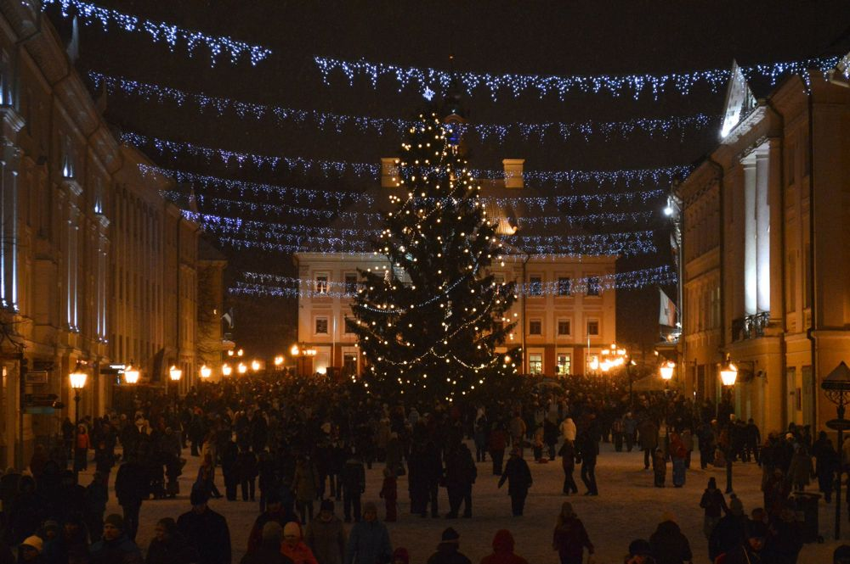
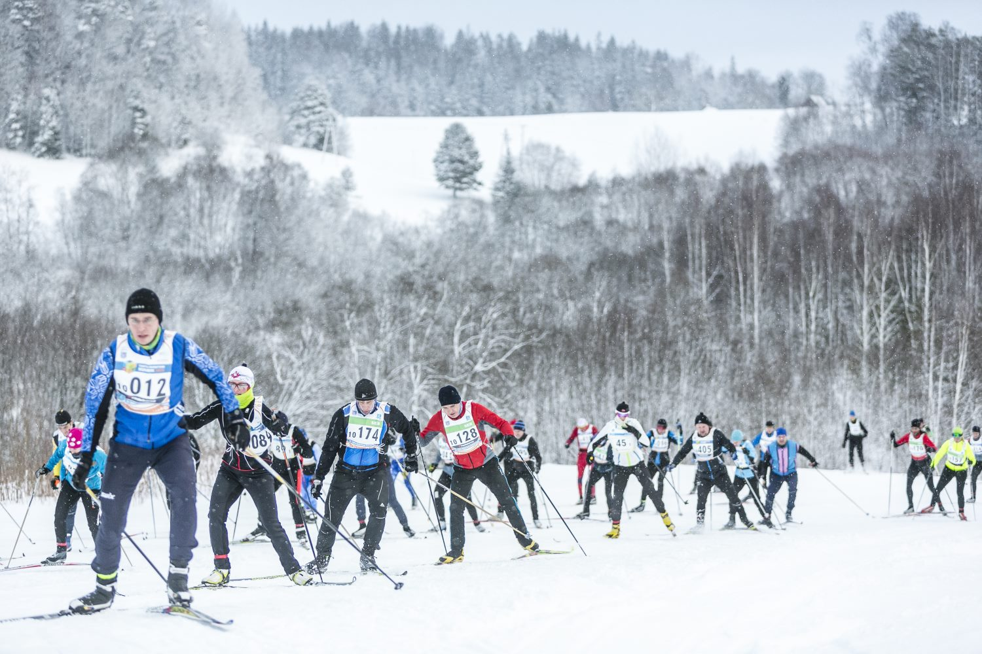
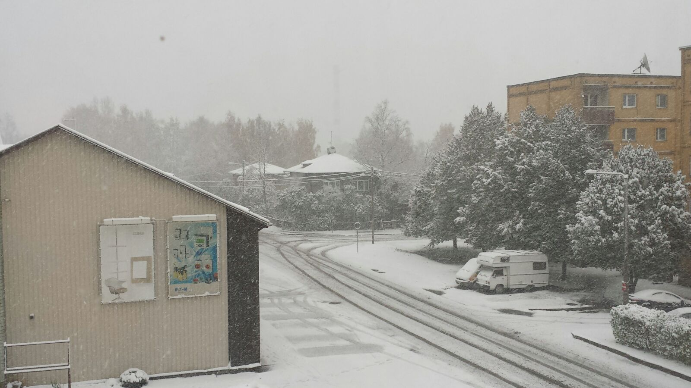

Slide 5
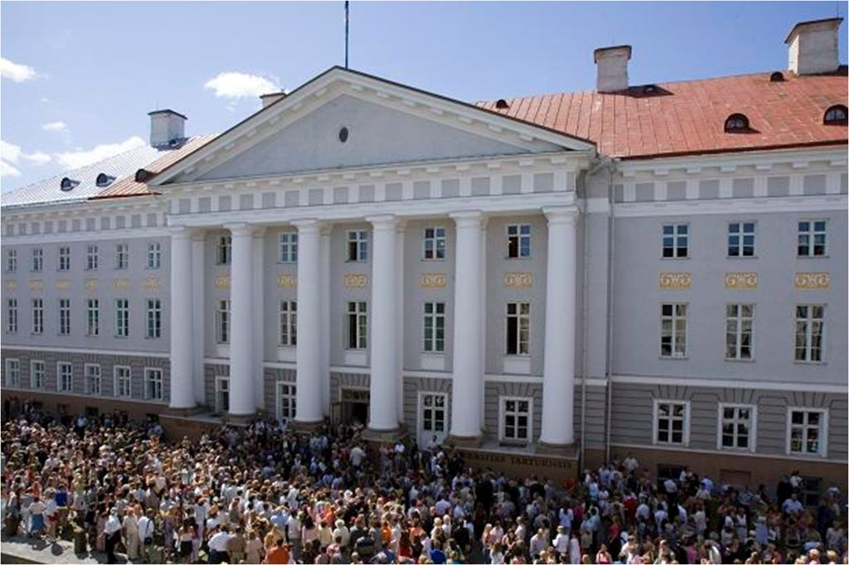

Academic excellence since 1632

Slide 6
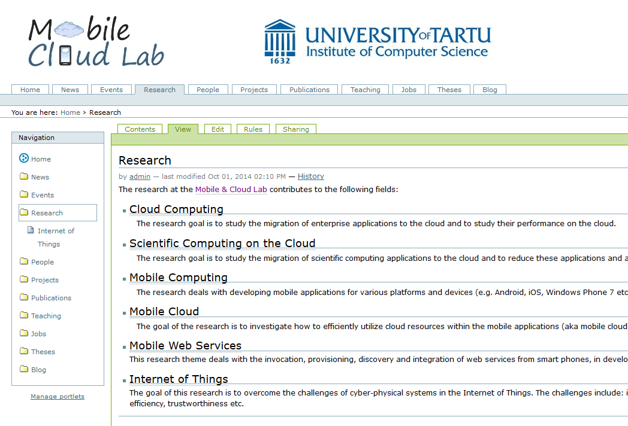
Main Research Activities

Slide 7
Outline
Layers of Cloud-based IoT
Mobile Web Services
Mobile Cloud Binding Models
  Task delegation
  Code offloading
Cloud-based IoT Data Processing
  Fog computing
Research Roadmap

Slide 8
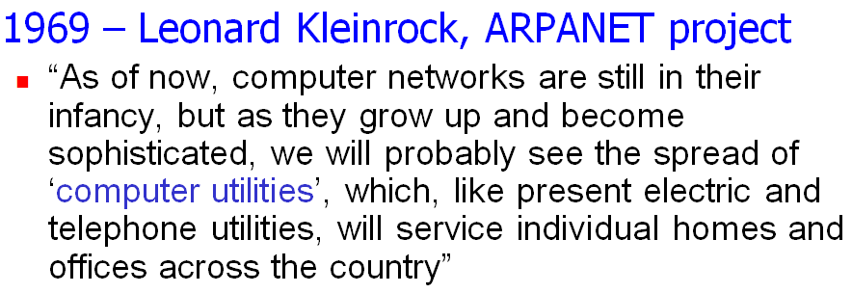
Cloud Computing
Computing as a utility
  Utility services e.g. water, electricity, gas etc
  Consumers pay based on their usage
Cloud Computing characteristics
  Illusion of infinite resources
  No up-front cost
  Fine-grained billing (e.g. hourly)

Slide 9
Potential of Cloud Computing
Cloud computing has emerged as one of the most prominent platforms instigating
  Enterprise applications
  Social networking applications etc.
Now IoT is emerging as another important domain
  In realizing smart environment,
  smart cities, smart healthcare etc.
Cloud has huge potential to drive IoT
Cloud Computing
Mobile Computing
Internet of Things

Slide 10
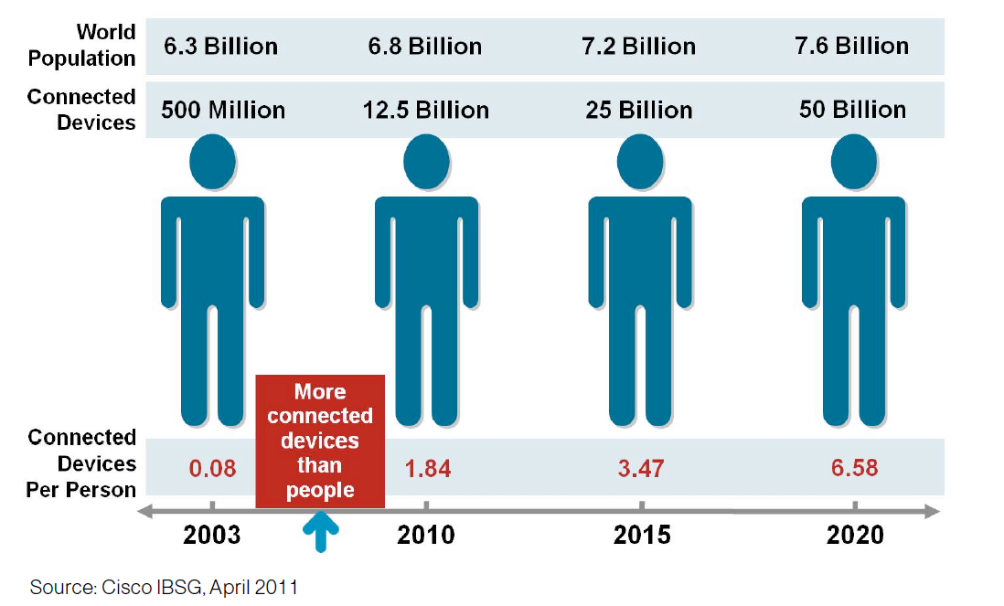
Internet of Things (IoT)
IoT allows people and things to be connected
  Anytime, Anyplace, with Anything and Anyone, ideally using Any path/network and Any service [European Research Cluster on IoT]
More connected devices than people
Cisco believes the market size will be $19 trillion by 2025
Notes:
A thing,
Can be a person with a heart monitor implant
A farm animal with a biochip transponder
An automobile that has built-in sensors
Other natural or man-made objects
With unique identifier and the ability to communicate over the internet without requiring human interaction.
More connected things than people happened in 2008

Slide 11
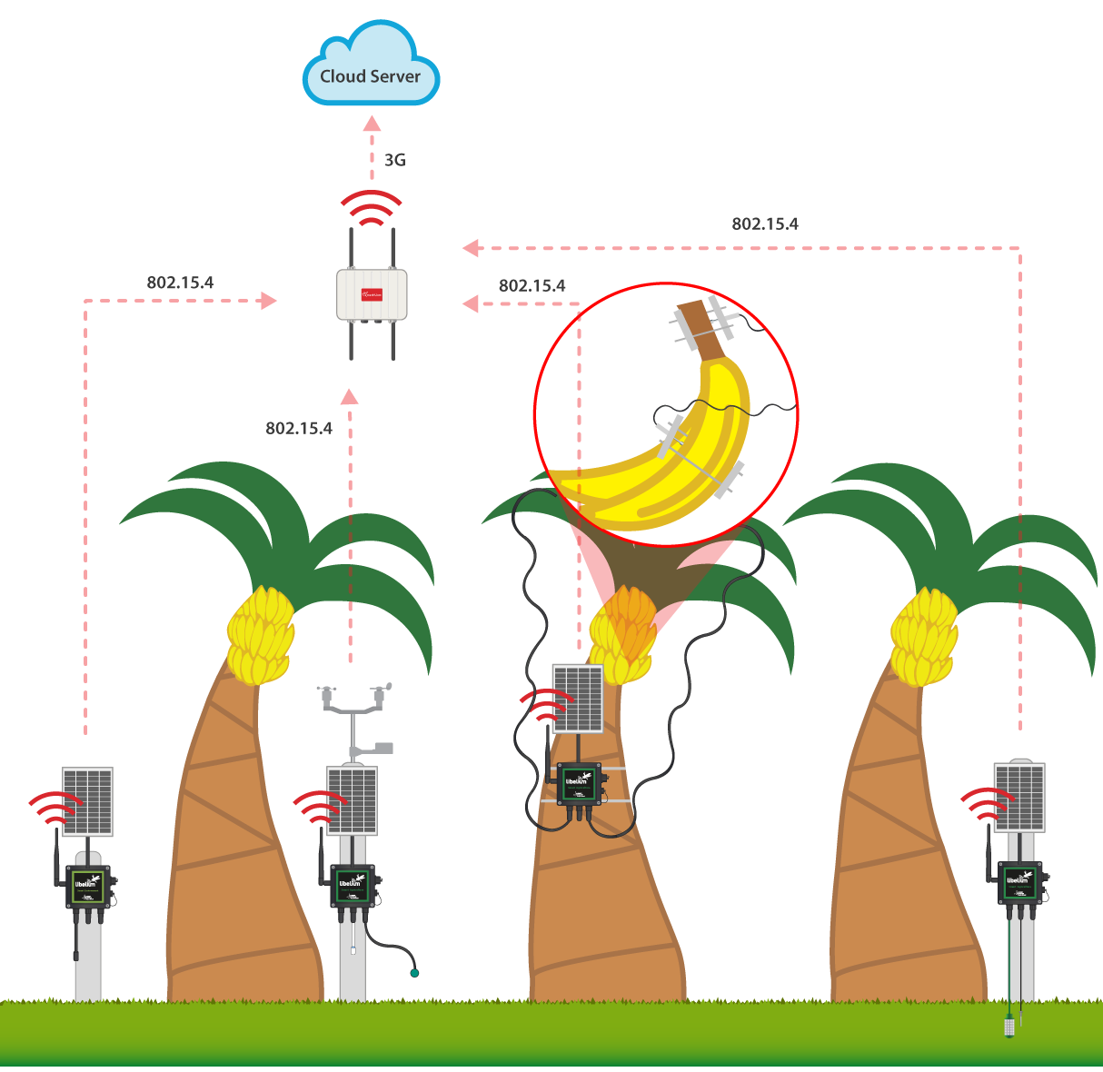
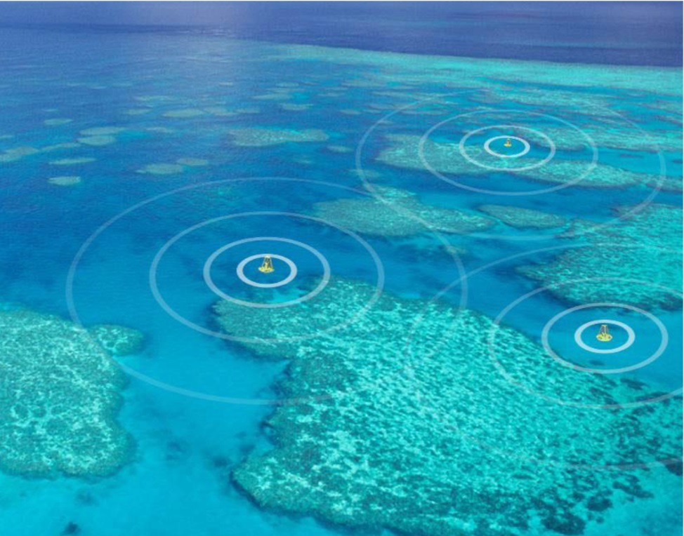
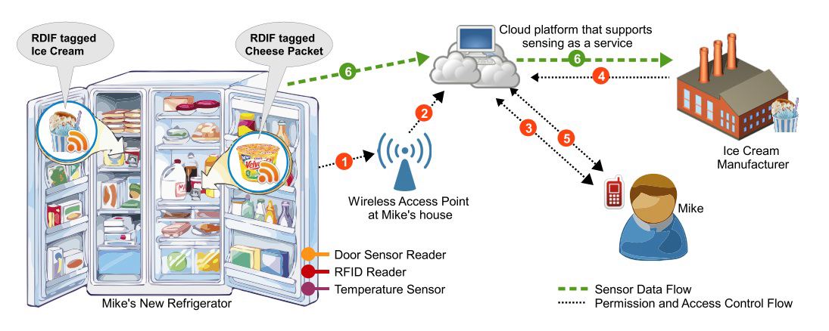
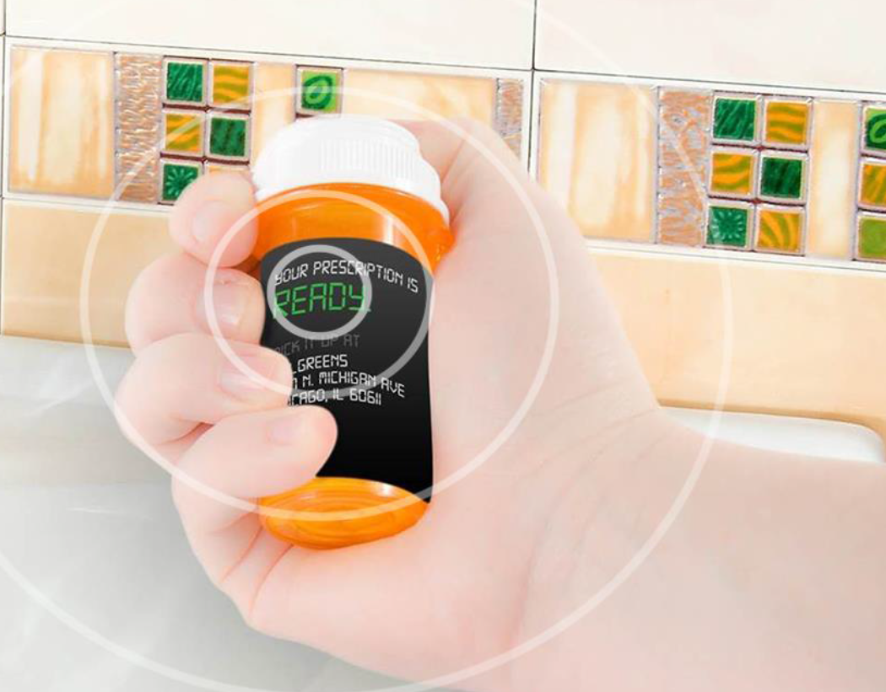
IoT - Scenarios
Environment Protection
Smart Home
Smart Healthcare
Smart Agriculture
[Kip Compton]
[Perera et al, TETT 2014]
[http://www.libelium.com/improving-banana-crops-production-and-agricultural-sustainability-in-colombia-using-sensor-networks/ ]
Notes:
Environment protection
Great Barrier Reef in Australia
Buoys equipped with sensors collect biological, physical, and chemical data to minimize and prevent reef damage
Smart healthcare
Medication in The United States
Smart pill bottles remind patients to take their medication and records that the patient has taken the correct dosage
Smart Agriculture
Minimizing the Use of Insecticides
Smart trapping solutions compile data and map the number of different types of insects that have been detected
Crop flood, decrease of oxygen in the soil, high humidity, low temperatures and low luminosity cause a lower plant development and an a bigger predisposition to be affected by plagues and diseases. During winter campaign, the great increase of plagues and diseases makes pesticides vigilance and control something vital for producers. The suitable technological developments allow to reach this goal.
For this reason, Red Tecnoparque Colombia has selected Libelium Waspmote Plug & Sense! Sensor Platform to develop a Smart Farming project with remote sensors. Plantain crops has been monitored with different sensors added to Waspmote Plug & Sense!:
Waspmote Plug & Sense! Smart Agriculture:
Digital Humidity & Temperature
Soil moisture.
Soil temperature.
Trunk diameter.
Fruit diameter.
Pluviometer.
Solar radiation.
Waspmote Plug & Sense! Smart Environment:
Ammonia (NH₃)
Monitoring these parameters, Redcom Tecnoparque is remotely supervising ambient and agronomic variations to investigate new banana varieties. This solution also lets them to know harvesting projection, to optimize water usage, to prevent plagues and diseases, to reduce fertilizers consumption and to catalogue soils depending on climate and culture.
Waspmote Plug & Sense! Sensor Platforms communicate with Meshlium Gateway through 802.15.4 protocols while data is sent to the Cloud via 3G and GPRS. The information is visualized in an own cloud-based application for the project. The platform is accessible through any computer and also by a mobile application.

Slide 12


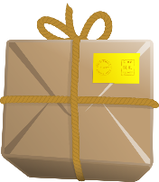
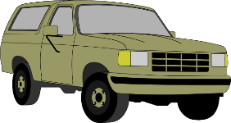
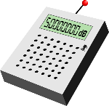


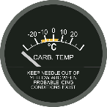
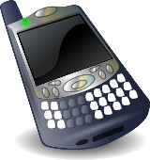
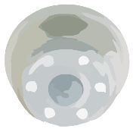

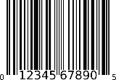
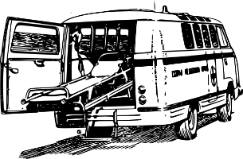
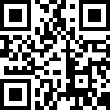
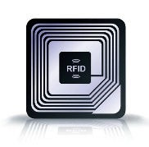
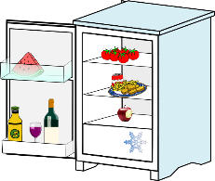


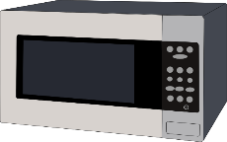
Internet of Things – Challenges
How do we communicate automatically?
How to provide energy efficient services?
[Chang et al, ICWS 2015]
Sensors
Tags
Mobile Things
[Chang et al, SCC 2015;
Liyanage et al, MS 2015]
Appliances & Facilities
How to interact
with ‘things’ directly?
Notes:
“The Internet of Things allows people and things to be connected Anytime, Anyplace, with Anything and Anyone, ideally using Any path/network and Any service”—(Guillemin and Friess, 2009)
US National Intelligence Council has predicted that “by 2025 Internet nodes may reside in everyday things–food packages, furniture, paper documents, and more”
UK + Germany governments supported £73 million for IoT (2014).
China government is planning to invest $800 million by 2015.

Slide 13
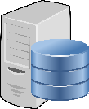


















Layers of Cloud-based IoT
Remote Cloud-based
processing
Proxy
Storage
Processing
Connectivity nodes &
Embedded processing
Sensing and smart devices
Notes:
Analogy of wisdom

Slide 14
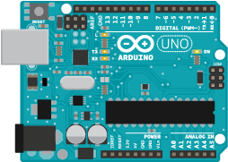
Sensing and Smart Devices
IoT Devices
  Sensors and actuators
  Motion, Temp, Light, Open/Close, Video,
  Reading, Power on/off/dimm etc.
Communication protocols
  Wireless and wired
  Protocols such as ZigBee, Z-Wave, Wi-Fi/Wi-Fi Direct, Bluetooth etc.
Arduino & Raspberry PI
  For rapid prototyping
Notes:
ZigBee is an IEEE 802.15.4-based specification for a suite of high-level communication protocols used to create personal area networks with small, low-power digital radios.
The technology defined by the ZigBee specification is intended to be simpler and less expensive than other wireless personal area networks (WPANs), such as Bluetooth or Wi-Fi. Applications include wireless light switches, electrical meters with in-home-displays, traffic management systems, and other consumer and industrial equipment that requires short-range low-rate wireless data transfer.
----------------------------
ULE
ULE addresses Ultra-Low Energy application requirements by introducing optimized communication methods. Identified with low power consumption, low latency, long range, moderate data rate and value-added complementary voice capabilities, ULE is the best-of-class technology which represents the next evolution in home networking.
ULE is based on DECT (Digital Enhanced Cordless Telecommunications) which is the de-facto standard for residential and business cordless phone communications worldwide.
-----------------------------------
Z-Wave is a wireless technology that makes regular household products, like lights, door locks and thermostats "smart". Z-Wave products "talk" to each other wirelessly and securely and can be accessed and controlled on your phone, tablet or pc.
---------------------------------
The EnOcean technology is an energy harvesting wireless technology used primarily in building automation systems, and is also applied to other applications in industry, transportation, logistics and smart homes. Modules based on EnOcean technology combine micro energy converters with ultra low power electronics, and enable wireless communications between batteryless wireless sensors, switches, controllers and gateways.
In March 2012, the EnOcean wireless standard was ratified as the international standard ISO/IEC 14543-3-10.^{[1]} The standard covers the OSI (Open Systems Interconnection) layers 1-3 which are the physical, data link and networking layers.
The energy harvesting wireless modules are manufactured and marketed by the company EnOcean which is based in Oberhaching, Germany. EnOcean offers its technology and licenses for the patented features within the EnOcean Alliance framework.
------------------------
The Raspberry Pi is a series of credit card–sized single-board computers developed in Pencoed, Wales by the Raspberry Pi Foundation with the intention of promoting the teaching of basic computer science in schools and developing countries.^{[6][7][8]} The original Raspberry Pi and Raspberry Pi 2 are manufactured in several board configurations through licensed manufacturing agreements with Newark element14 (Premier Farnell), RS Components and Egoman.^{[9]} The hardware is the same across all manufacturers.
All Raspberry Pis include a CPU with either an ARMv6-compatible core or newer ARMv7 cores and have included on a chip with VideoCore IV GPU,^{[10]} and have at 256 megabytes of RAM, except later models (models B and B+) that have 512 MB,^{[3][11]} and the Pi 2 at 1 GB. They have Secure Digital (SD) (models A and B) or MicroSD (models A+ and B+) sockets for boot media and persistent storage.
-------------------------------
Arduino is an open-source computer hardware and software company, project and user community that designs and manufactures microcontroller-based kits for building digital devices and interactive objects that can sense and control objects in the physical world.^{[1]}

Slide 15
Gateway/Connectivity Nodes
Primarily deals with the sensor data acquisition and provisioning
Embedded processing saves the communication latencies
Predictive analytics
  Collect data only occasionally
Mobiles can also participate
  This brings in the scope of mobile web services and mobile cloud services for IoT

Slide 16
Advances in Mobile Technologies
Mobile – The Seventh Mass Media Channel [Tomi T Ahonen]
Embedded Hardware
  Camera, Wifi, sensors such as accelerometer, magnetic field, etc.
Higher data transmission and ubiquitous access to Internet
  3G, 4G, 5G, Wifi

Slide 17

Mobile Hosts in Enterprise Service Integration
Web services (WS)
  Enable enterprise integration
Mobile web services (MWS) [LA, OMA]
  Weather, search, maps etc.
REST /
[Srirama et al, ICIW 2006;
Srirama, 2008]
Mobile Social Networks in proximity [Chang et al, ICSOC 2012; PMC 2014]
  UDDI - Universal Description, Discovery and Integration
  WSDL - Web Services Description Language
Notes:
Web services are software components that support interoperable machine-to-machine interaction over a network and whose public interfaces are defined and described using xml based stndards.
Google serach engine / Amazon product information / stock quotes
Web services are software components that enable Application-to-app communication.
The device capabilities of today’s smart phones and PDAs have increased significantly, both in terms of processing powers and memory capabilities.
Concurrent to the device capabilities, the data transmission rates across the wireless network also have increased significantly.
These developments combined with web services domain lead mobile web services.
Mobile terminals accessing the web services cater for anytime, anywhere access to services. Some interesting services are providing e-mail, information search, company news for employees who travel regularly.

Slide 18
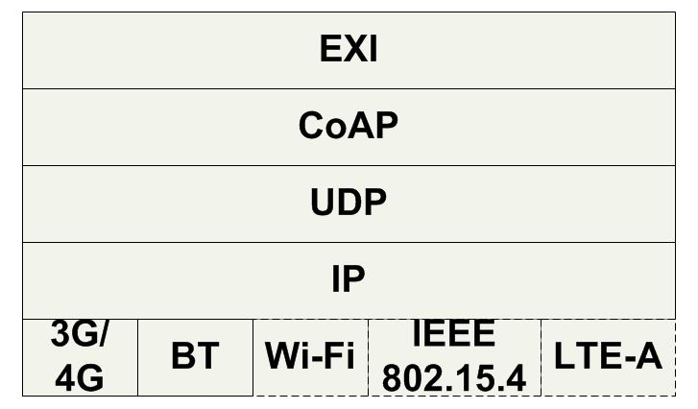
Light-weight Mobile Hosts for Sensor Mediation
Mobile Host can directly provide the collected sensor information
  Data can be collected based on need
Ideal MWS Protocol Stack
  Things have improved significantly over the years
  Bluetooth Low Energy (BTLE) for local service discovery and interaction
  UDP instead of TCP
  Constrained Application
  Protocol (CoAP)
  Efficient XML Interchange (EXI)
[Liyanage et al, MS 2015]
Notes:
3G/4G mobile Internet for global service interaction
Wi-Fi/Wi-Fi Direct, Bluetooth (BT)/BTLE, IEEE 802.15.4(e.g., ZigBee), or LTE-A (LTE Direct) for local service interaction
LTE Advanced is a mobile communication standard and a major enhancement of the Long Term Evolution (LTE) standard. It was formally submitted as a candidate 4G system to ITU-T in late 2009 as meeting the requirements of the IMT-Advanced standard, and was standardized by the 3rd Generation Partnership Project (3GPP) in March 2011 as 3GPP Release 10.^{[1]}
Bluetooth Low Energy (BTLE) for local service discovery and to collect data from external environmental sensors
BTLE Advertising Packet has the data which can be utilized by the client devices without an established connection
UDP instead of TCP
UDP has a simple header (20 Bytes)
UDP doesn’t maintain connected sessions over the time
--------------
Constrained Application Protocol (CoAP)
Built on top of the User Datagram Protocol (UDP)
Significantly lower overhead (4 byte header size )
Multicast support contrast to the TCP
Including REST methods as GET, POST, PUT and DELETE
End-points use the Constrained RESTful Environments (CoRE) Link Format for the service discovery
Example: coap://myserver.com:5683/.well-known/core
Efficient XML Interchange (EXI)
"schema-informed" compression
The binary compression on the CoAP payload has more compression rate over XML

Slide 19
Limitations with Mobiles
Longer battery life
  Battery lasts only for 1-2 hours for continuous computing
Same quality of experience as on desktops
  Weaker CPU and memory
  Storage capacity
Still it is a good idea to take the support of external resources
  For building resource intensive mobile applications
  Brings in the scope for cloud computing

Slide 20
Mobile Cloud Applications
Bring the cloud infrastructure to the proximity of the mobile user
Mobile has significant advantage by going cloud-aware
  Increased data storage capacity
  Availability of unlimited processing power
  PC-like functionality for mobile applications
  Extended battery life (energy efficiency)
Notes:
Mobile should possess keys from different cloud providers
Should use different API

Slide 21
Mobile Cloud – Interpretation
We should not see Mobile Cloud to be just a scenario where mobile is taking the help of a much powerful machine!!!
We should not see cloud as just a pool of virtual machines
Mobile Cloud based system should take advantage of some of the key intrinsic characteristics of cloud efficiently
  Elasticity & AutoScaling
  Utility computing models
  Parallelization (e.g., using MapReduce)
Notes:
If the task or method is delegated/offloaded to just a server (near by) it is not Mobile Cloud

Slide 22
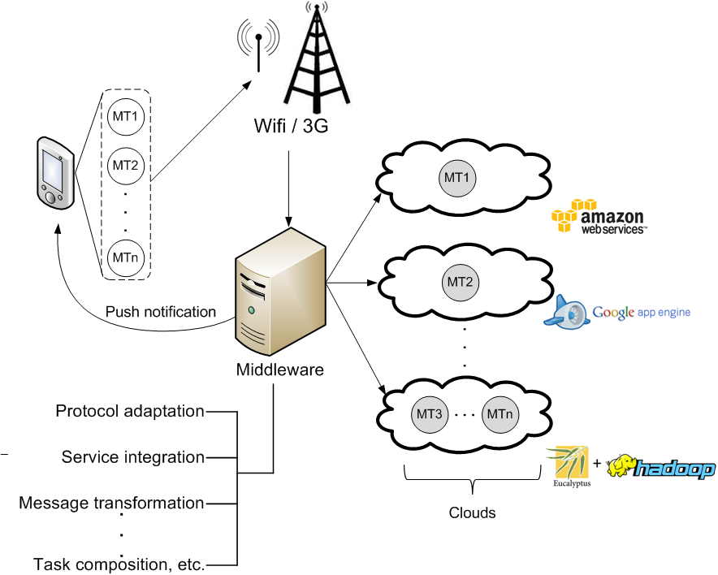
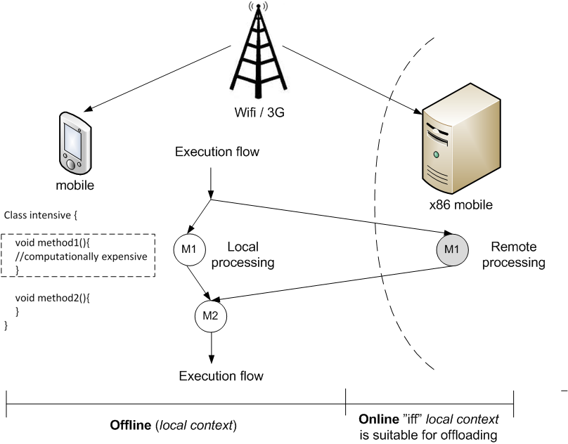
Mobile cloud - Binding models
MCM
Task Delegation
Code Offloading
[Flores and Srirama, JSS 2014]
[Flores et al, IEEE Communications Mag 2015]

Slide 23
Task Delegation
Follows traditional SOA model to invoke services
  Similar to mobile Web service client
Typical scenarios
  Process intensive services
    Face recognition, sensor mining etc.
  Data Synchronization (SyncML, Funambol, Google Sync)
    Calendar, contacts etc.
Critical challenges were (~2010)
  Cloud interoperability
  Unavailability of standards and mobile platform specific API

Slide 24


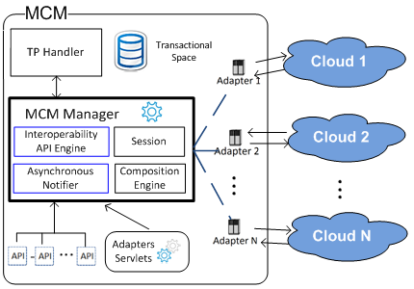

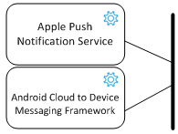
Mobile Cloud Middleware
[Srirama and Paniagua, MS 2013]
Google Cloud Messaging
Microsoft Push Notification Service
[Warren et al, IEEE PC 2014]
[Flores et al, MoMM 2011; Flores and Srirama, JSS 2014]
Notes:
Means to parallelize the tasks and take advantage of Cloud’s intrinsic characteristics
Firebase Cloud Messaging - Google

Slide 25
MCM – enables
Interoperability between different Cloud Services (IaaS, SaaS, PaaS) and Providers (Amazon, OpenStack, Eucalyptus, etc.)
Provides an abstraction layer on top of API
Composition of different Cloud Services
Asynchronous communication between the device and MCM
Means to parallelize the tasks and take advantage of Cloud’s intrinsic characteristics

Slide 26
CroudSTag – Scenario
CroudSTag takes the pictures/videos from the cloud and tries to recognize people
  Pictures/Videos are actually taken by the phone
  Processes the videos
  Recognizes people using facial recognition technologies
Reports the user a list of people recognized in the pictures
The user decides whether to add them or not to the social group
The people selected by the user receive a message in facebook inviting them to join the social group
[Srirama et al, PCS 2011; SOCA 2012]

Slide 27
CroudSTag [Srirama et al, PCS 2011;
SOCA 2012]
Cloud services used
  Media storage on Amazon S3
  Processing videos on Elastic MapReduce
  face.com to recognize people on facebook
  Starting social group on facebook

Slide 28
Other applications
Zompopo [Srirama et al, NGMAST 2011]
  Intelligent calendar, by mining accelerometer sensor data
Bakabs [Paniagua et al, iiWAS-2011]
  Managing the Cloud resources from mobile
Sensor data analysis
  Human activity recognition
  Context aware gaming
  MapReduce based sensor data analysis [Paniagua et al, MobiWIS 2012]
SPiCa: A Social Private Cloud Computing Application Framework [Chang et al, MUM 2014]

Slide 29
Adaptive Workflow Mediation Framework
Task delegation is a reality!!!
  Cloud providers also support different platforms
Mobile Host allows invocation of services on smartphones
So Peer-to-Peer (P2P) communication is possible
Extended the Mobile Host to also support workflow execution [Chang et al, ICSOC 2012; MUM 2014]
  To address challenges of discovery and quality of service (QoS) [Srirama et al, MW4SOC 2007]
  Tasks can move between mobile and middleware

Slide 30
Mobile cloud - Binding models
MCM
Task Delegation
Code Offloading
[Flores and Srirama, JSS 2014]
[Flores et al, IEEE Communications Mag 2015]

Slide 31
Code Offloading
Also known as Cyber-foraging [M. Satyanarayanan et al, PC 2009]
Mobile devices offload some of their heavy work to stronger surrogate machines
  within the vicinity (Cloudlets)
Notes:
For instance, a face
recognition app installed in device (which) offloads a task at
code level (what) under conditions (when) to a remote server
of type (where) to be executed (how) in parallel.

Slide 32
Major Components
Mobile
  Code profiler
  System profilers
  Decision engine
Cloud based surrogate platform
Major research challenges
  What, when, where and how to offload?

Slide 33
Some of the well known frameworks
MAUI
  Manual annotations [Cuervo et al., 2010]
CloneCloud
  Code profilers & Automated process [Chun et al., 2011]
ThinkAir
  Manual annotations and scalability [Kosta et al, 2012]
EMCO [Flores and Srirama, MCS 2013]
  Improved offloading by analysing the traces
mCloud [Zhou et al, Cloud 2015; TSC 2016] & etc.
  A context-aware offloading framework for heterogeneous mobile cloud
Work in controlled environments like nearby servers
  However, none can be adapted for real life applications
Notes:
MAUI - Duke university and Microsoft Research
CloneCloud – Intel Research and Princeton university
Thinkair - Deustche Telekom Labs

Slide 34
Challenges and technical problems
Inaccurate code profiling
  Code has non-deterministic behaviour during runtime
    Based on factors such as input, type of device, execution environment, CPU, memory etc.
  Some code cannot be profiled (e.g. REST)
Integration complexity
  Surrogate should have similar execution environment
Dynamic configuration of the system
Offloading scalability and offloading as a service
  Should also consider about resource availability of Cloud
[Flores et al, IEEE Communications Mag 2015 ]

Slide 35
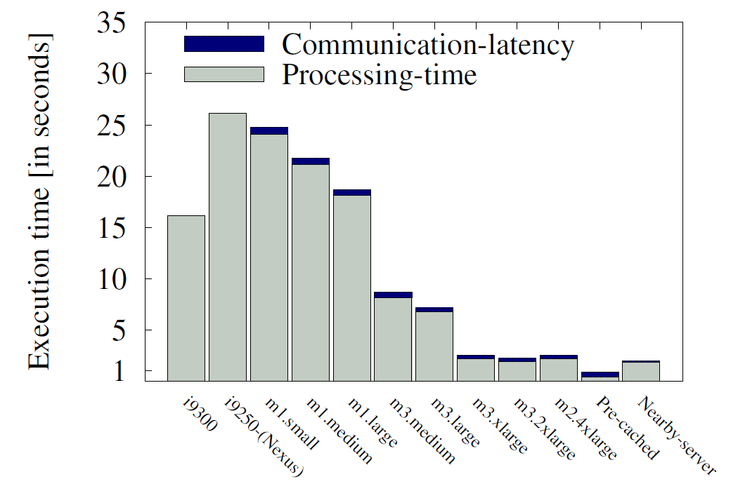
Practical adaptability of offloading
[Srirama, CSIICT 2017]
Applications that can benefit became limited with increase in device capacities

Slide 36
Multi-tenancy for code offloading
Auto-scaling becomes a challenge

Slide 37
Dynamic configuration
Vast resource allocation choices in the cloud ecosystem
and the large diversity of smartphones make the context very
variable

Slide 38
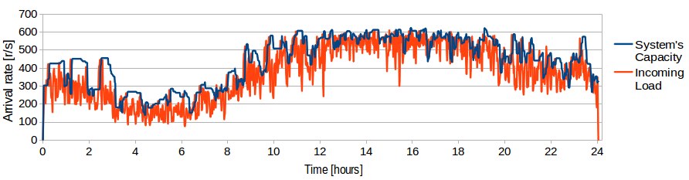
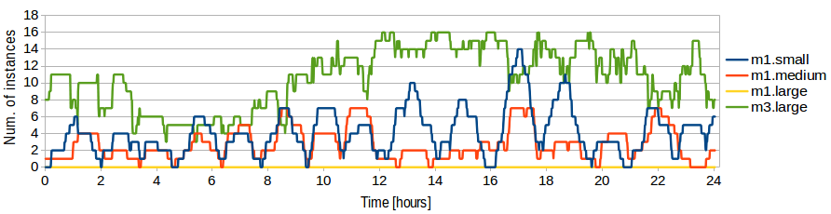
Remote Cloud-based Processing - Challenges
Dynamic deployment of applications on cloud
  Standardization efforts from CloudML
  [REMICS EU FP7; MODAClouds EU FP7; Srirama et al, Cloud 2016]
Auto-scaling & Resource provisioning
  Taking advantage of cloud heterogeneity
  Cloud cost models of fine-grained billing (e.g. hourly) [Srirama and Ostovar, CloudCom 2014]
Notes:
In Mobile Cloud we discussed certain challenges which are generic for cloud
Dynamic deployment of applications on cloud
Auto-scaling
Resource provisioning
Parallel processing

Slide 39
IoT Data Processing on Cloud
Enormous amounts of unstructured data
  In Zetabytes (10²¹ bytes) by 2020 [TelecomEngine]
  Has to be properly stored, analysed and interpreted and presented
Big data acquisition and analytics
Economics of Cloud Providers
  Cloud Computing providers bring a shift from high reliability/availability servers to commodity servers
  Replication of data and computation
    MapReduce [Dean and Ghemawat, ACM 2008]
Notes:
The data from single sensor could be not more than some MBs per year however; cumulative data from all deployed sensors can scale up and reach in gigabytes or petabytes depending upon the speed of deployment.
Message queues such as Apache Kafka can be used to buffer and feed the data into stream processing systems such as Apache Storm or to leverage the stream part of generic engines such as Apache Spark.
http://www.telecomengine.com/article/intelligent-data-handling-success-mantra-iot
Digital forgetting

Slide 40
Adapting computing problems to cloud
Designed a classification on how the algorithms can be adapted to MR [Srirama et al, FGCS 2012]
  Algorithm → single MapReduce job
    Monte Carlo, RSA breaking
  Algorithm → n MapReduce jobs
    CLARA (Clustering), Matrix Multiplication
  Each iteration in algorithm → single MapReduce job
    PAM (Clustering)
  Each iteration in algorithm → n MapReduce jobs
    Conjugate Gradient
Applicable especially for Hadoop MapReduce

Slide 41
Alternative approaches
Restructuring algorithms into non-iterative versions
  CLARA instead of PAM [Jakovits and Srirama, Nordicloud 2013]
Alternative MapReduce implementations that are designed to handle iterative algorithms [Jakovits and Srirama, HPCS 2014]
  E.g. Twister, HaLoop, Spark
Alternative distributed computing models
  Bulk Synchronous Parallel model [Valiant, 1990] [Jakovits et al, HPCS 2013]
  Built a fault-tolerant BSP framework (NEWT) [Kromonov et al, HPCS 2014]
Dynamic Algorithm Modeling Application (DAMA) [Jakovits and Srirama, CSIICT 2017]
Notes:
From PAM klustering to CLARA
CLARA is designed from the start to be more effective
From Conjugate Gradient to Monte Carlo Matrix Inverse
Result is much less effective
Does not work well with sparse matrices
Is generally very difficult to find an alternative that performs close to the original algoirithm
Can only be applied in small number of cases
Requires a great understanding of the involved algorithms and the framework it is applyed on.
------------------------------
But, as a result alternative Mapreduce frameworks often:
step away from the classical MapReduce model
give up advantages of the MapReduce model,
Fault tolerance
or multiple concurrent reduce tasks
are less stable,
are more complicated to use and debug
------------------
Bulk Synchronous Parallel model
Created by Valiant in 1990
Google gave up using MapReduce for large-scale complex graph processing
Designed a new framework Pregel instead that uses Bulk Synchronous parallel model instead of MapReduce
Details published in 2010
Pregel is proprietary.
Like with MapReduce, third parties have designed alternative freely usable versions:
jPregel
Hama
Giraph

Slide 42
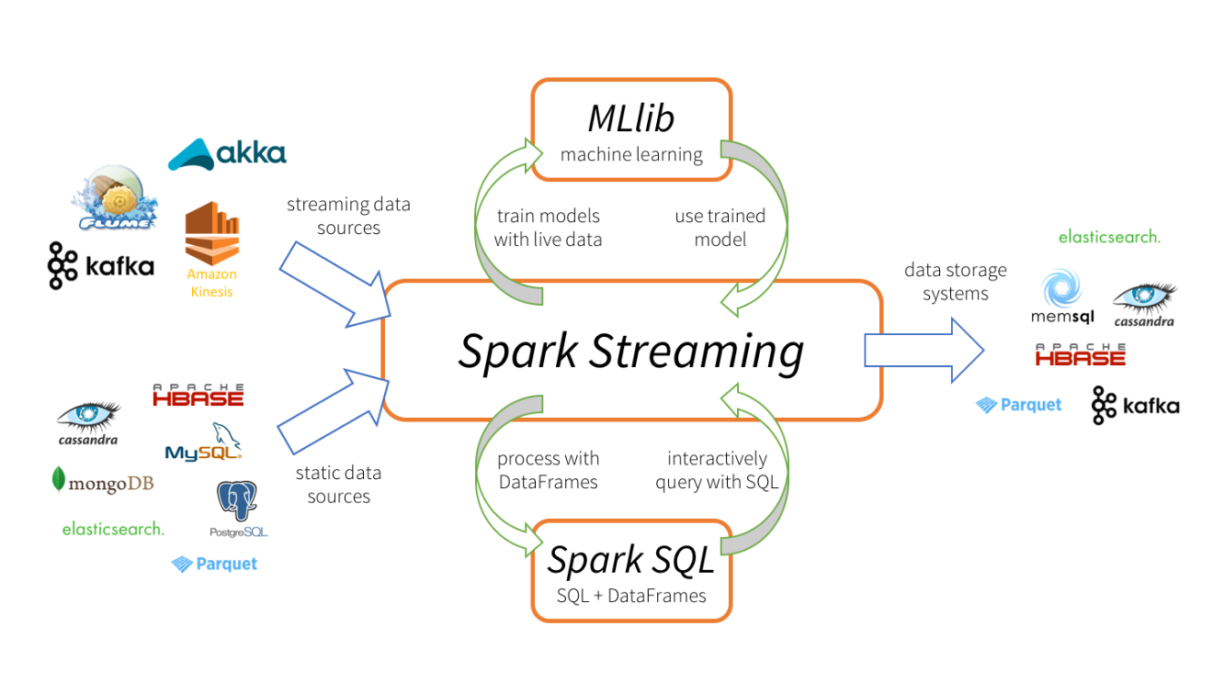
IoT Data Processing on Cloud - continued
IoT mostly deals with streaming data
  Message queues such as Apache Kafka to buffer and feed the data into stream processing systems such as Apache Storm
  Apache Spark streaming
https://www.datanami.com/2015/11/30/spark-streaming-what-is-it-and-whos-using-it/
Notes:
The data from single sensor could be not more than some MBs per year however; cumulative data from all deployed sensors can scale up and reach in gigabytes or petabytes depending upon the speed of deployment.
Message queues such as Apache Kafka can be used to buffer and feed the data into stream processing systems such as Apache Storm or to leverage the stream part of generic engines such as Apache Spark.
http://www.telecomengine.com/article/intelligent-data-handling-success-mantra-iot
Digital forgetting
Spark Streaming ecosystem: Spark Streaming can consume static and streaming data from various sources, process data using Spark SQL and DataFrames, apply machine learning techniques from MLlib, and finally push out results to external data storage systems.
https://www.datanami.com/2015/11/30/spark-streaming-what-is-it-and-whos-using-it/

Slide 43
Issues with Cloud-centric IoT
Latency issues for applications with sub-second response requirements
Certain scenarios do not let the data move to cloud
Fog computing [Chang et al, AINA 2017; Mass et al, SCC 2016]
  Processing across all the layers, including network switches/routers
  Discovery of fog services [Soo et al, CPSCom 2016]
  Docker based container solutions
  Optimal application placement across fog topology
Mist computing
  Processing at the edge devices
  Dynamic provisioning of a platform for process execution [Liyanage et al, PDCAT 2016]

Slide 44









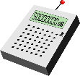


Scenario: Disabled Person Trying to Avoid Crowd in Urban Areas
Let us assume everything we discussed so far works!
Utility Cloud
End of Story?
Discovery Servers
Metadata
Discovery
Process
Delegation
Proximal Discovery
Smart Objects (things)
Notes:
And focus at a specific problem

Slide 45





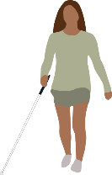

Real-time IoT Service Discovery
[Chang et al, SCC 2015]
Discovery Servers
Discovery Servers
Discovery
Server
Smart
Objects
n₄
Smart
Objects
n₂
n₅
n₁
Smart Objects
n₃
Discover
Discover
Discover
SCORPII
Utility Cloud Side
SCORPII Mobile Host
SCORPII
Utility Cloud Side
SCORPII Mobile Host
SCORPII Mobile Host
Timestamp 1
Timestamp 2
Timestamp 3

Slide 46
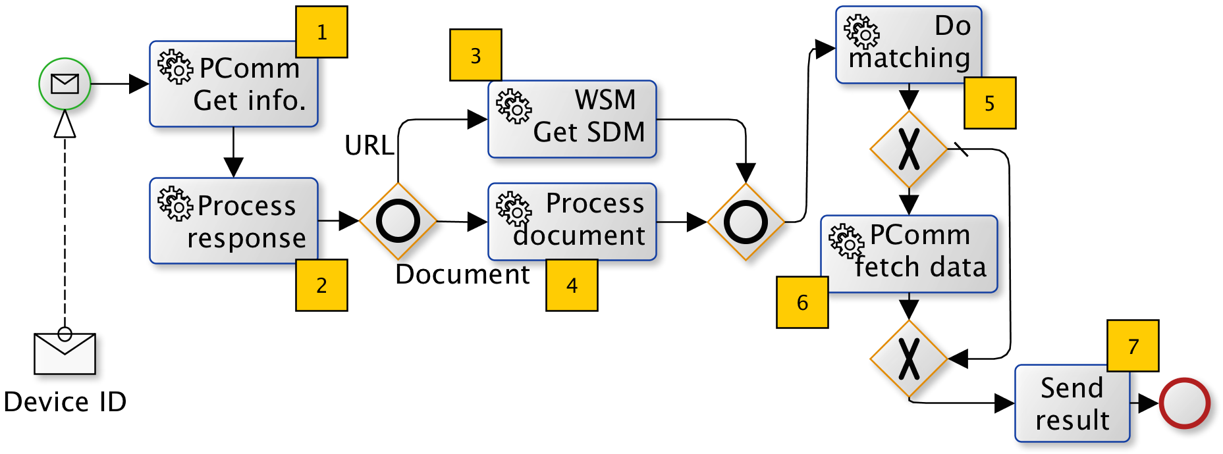
Discovery Workflow
Workflow approach selection
Fuzzy sets and Cost Performance Index
[Chang et al, SCC 2015]

Slide 47
Research Roadmap - IoT
Domain Specific
Service
Provisioning
Smart Healthcare;
Environmental Monitoring;
Smart Cities etc.
Elastic Cloud Processing;
MapReduce & Apache Hadoop Ecosystem;
Machine Learning;
Stream Data Processing;
Big Data Acquisition & Analytics
Service-Oriented Computing;
Process Management;
IoT Platforms & Fog Computing;
Reliable Adaptive Middleware
Mobile Computing;
Wireless Sensor &
Actuator Networks;
Energy-Efficient and Cost-Efficient Connected Things
[Srirama, CSIICT 2017]
Notes:
Our research progresses based on this big umbrella
“The most profound technologies are those that disappear. They weave themselves into the fabric of everyday life until they are indistinguishable from it.” This statement in Mark Weiser’s well-known “The Computer for the Twenty-First Century” (Scientific American, 1991, pp. 66–75) has been a source of inspiration for many and still is an important guideline for the work in the Smart Future Initiative.
Weiser is widely considered to be the father of ubiquitous computing, a term he coined in 1988.

Slide 48
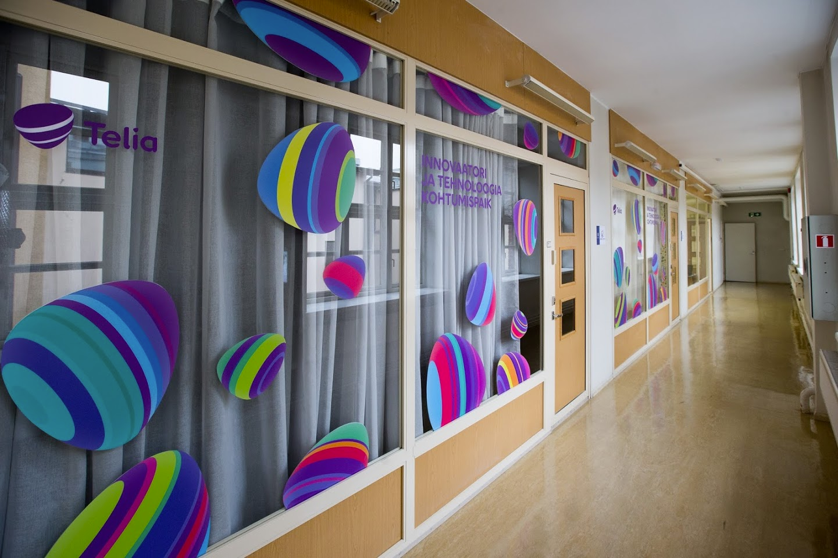
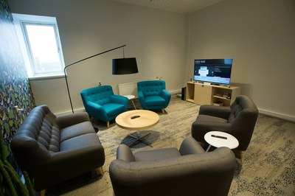
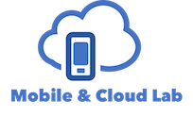

IoT and Smart Solutions Laboratory

Slide 49
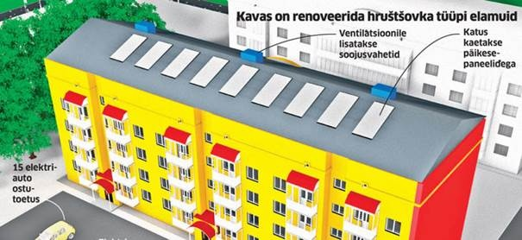
IoTSS Lab - Activities
IoT research [Chang et al, PMC 2014; Flores and Srirama, JSS 2014; Zhou et al, TSC 2016; Mass et al, SCC 2016; Chang et al, ICSOC 2012; Srirama, CSIICT 2017]
  Fog Computing, Mobile Cloud, Adaptive workflow mediation etc.
Design and develop IoT scenarios
  Testing facility for EU Horizon 2020 Smart Cities & Communities Lighthouse project SmartEnCity
We are also interested in sociological aspects
  How easy it is to use the IoT solutions?
  How people benefit from it?
  Behavioral aspects
Business models
  How to encourage people in using these smart technologies?
Notes:
In addition to this, University of Tartu is also participating in EU Horizon 2020 Smart Cities & Communities Lighthouse (SmartEnCity) project. The project is targeted at reconstruction of an existing city into a smart and energy-efficient community. Tartu is one of the planned pilot cities, and the project is targeted at renovating 900 Khrushchev-era apartments (23 houses). The project and the consortium will bring in the preliminary knowledge of building smart environments to ITEE and will provide us access to a significant user base where the future solutions of ITEE will be applied.
Vitoria (Spain), Tartu (Estonia) and Sonderborg (Denmark), 3 cities in SmartEnCity project.
https://eu-smartcities.eu/content/vitoria-tartu-and-sonderborg-join-h2020-smartencity-project
Behavioral aspects
e.g. We set up nice home, which regulates the heat in the room and the person opens the window.
Business models
How to encourage people in using these smart technologies
Giving back a lump sum amount at the end of the year

Slide 50


Thank you for your attention
srirama@ut.ee

