Slide 1


Fog Computing: Beyond Mobile and Cloud Centric Internet of Things
Satish Srirama
satish.srirama@ut.ee
Keynote, AICTE Sponsored International Conference on Recent Trends in IoT and Blockchain (ICRTIB-2019), Gunupur, India
19th October 2019
Notes:
Ome Srirama Jai Vinayaka
Ome Srirama Jai Vinayaka
Ome Srirama Jai Vinayaka

Slide 2

Who am I
Head of Mobile & Cloud Lab, Institute of Computer Science, University of Tartu, Estonia
http://mc.cs.ut.ee
Notes:
Volume 46
Editors
IoT is one of the key focus areas of SPE

Slide 3
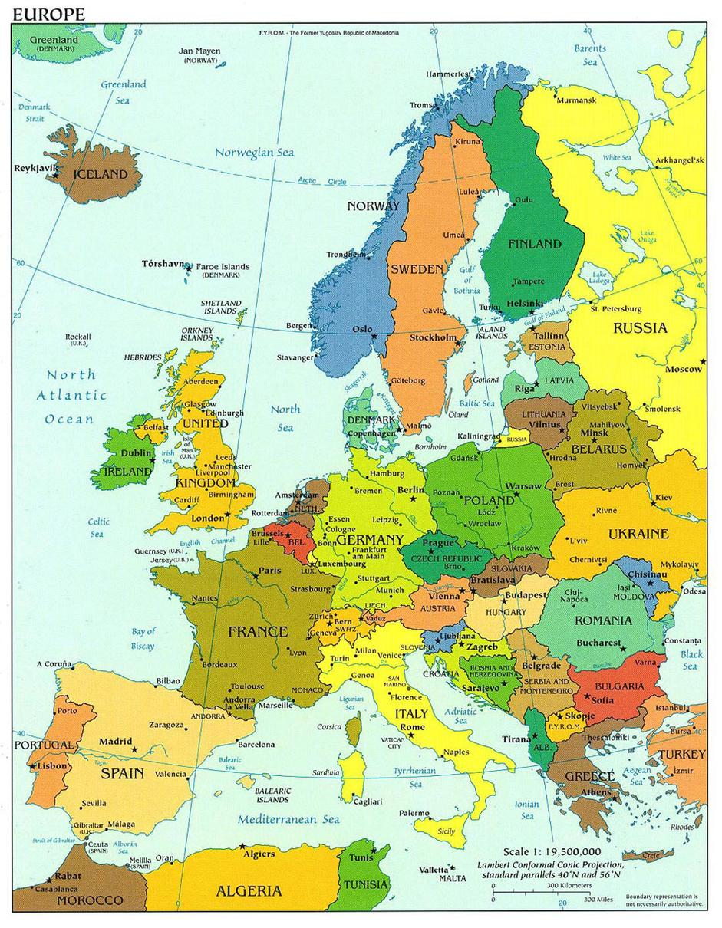
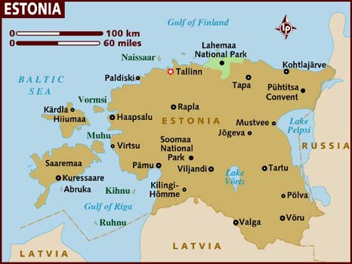
Estonia pop: 1,300,000
TARTU
Pop: 100,000

Slide 4
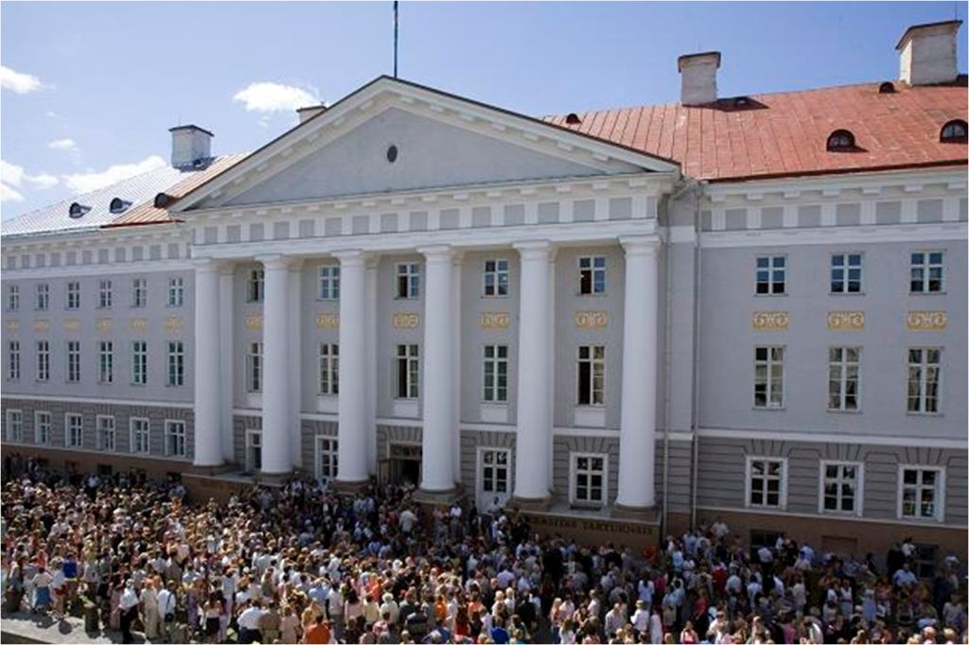

Academic excellence since 1632

Slide 5
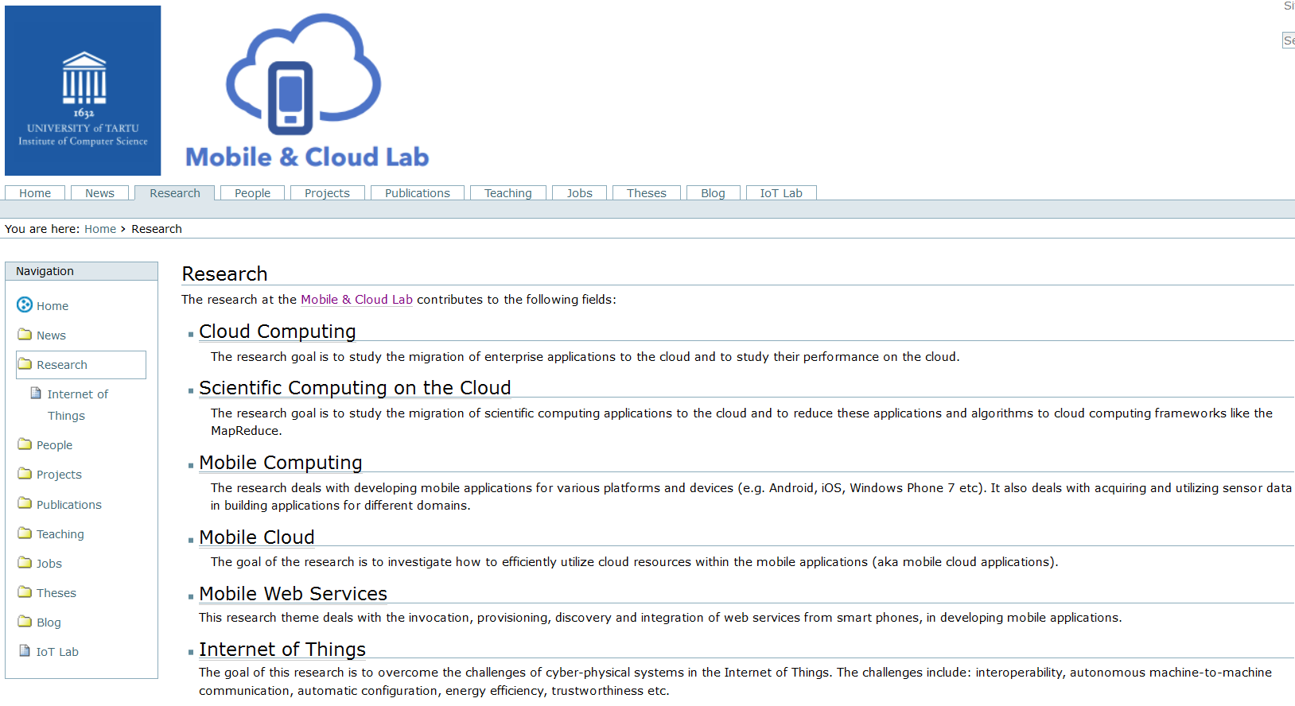
Main Research Activities

Slide 6
Outline
Layers of Cloud-based Internet of Things (IoT)
Mobile Web Services and Cloud Services
Issues with Cloud-centric IoT
Fog Computing & Research Roadmap
[Srirama, CSIICT 2017]

Slide 7
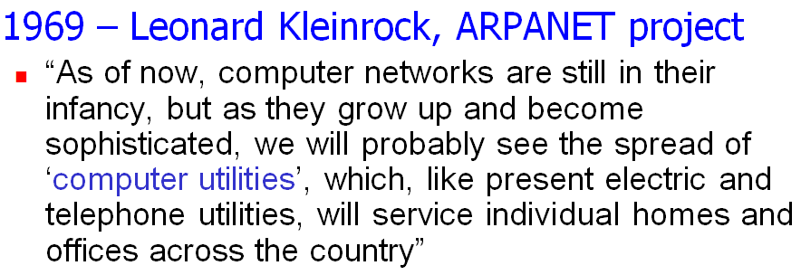
Cloud Computing
Computing as a utility
  Utility services e.g. water, electricity, gas etc
  Consumers pay based on their usage
Cloud Computing characteristics
  Illusion of infinite resources
  No up-front cost
  Fine-grained billing (e.g. hourly)
Notes:
Leonard Kleinrock (born June 13, 1934) is an American computer scientist. A professor at UCLA's (University of California, Los Angeles) Henry Samueli School of Engineering and Applied Science, he made several important contributions to the field of computer networking, in particular to the theoretical foundations of computer networking. He played an influential role in the development of the ARPANET, the precursor to the Internet, at UCLA.
The first message on the ARPANET was sent by UCLA student programmer Charley Kline, at 10:30 p.m, on October 29, 1969 from Boelter Hall 3420, the school's main engineering building.^{[13]} Supervised by Kleinrock, Kline transmitted from the university's SDS Sigma 7 host computer to the Stanford Research Institute's SDS 940 host computer.

Slide 8
Potential of Cloud Computing
Cloud computing has emerged as one of the most prominent platforms instigating
  Enterprise applications
  Social networking applications etc.
Now IoT is emerging as another important domain
  In realizing smart environment,
  smart cities, smart healthcare etc.
Cloud has huge potential to drive IoT
Cloud Computing
Mobile Computing
Internet of Things

Slide 9
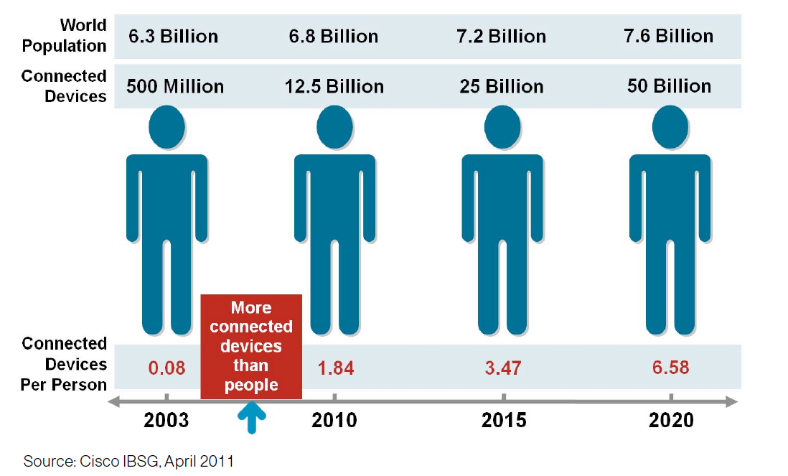
Internet of Things (IoT)
IoT allows people and things to be connected
  Anytime, Anyplace, with Anything and Anyone, ideally using Any path/network and Any service [European Research Cluster on IoT]
More connected devices than people
Cisco believes the market size will be $19 trillion by 2025
Notes:
A thing,
Can be a person with a heart monitor implant
A farm animal with a biochip transponder
An automobile that has built-in sensors
Other natural or man-made objects
With unique identifier and the ability to communicate over the internet without requiring human interaction.
More connected things than people happened in 2008

Slide 10



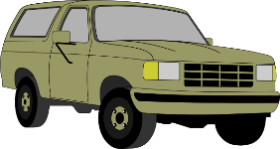
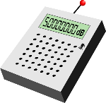


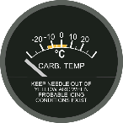
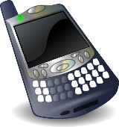
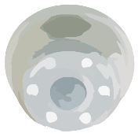


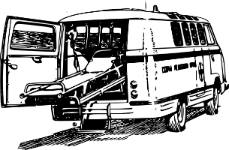

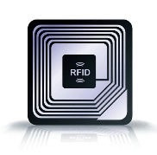
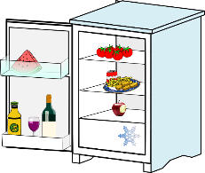


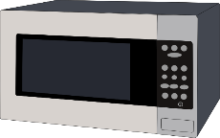
Internet of Things – Challenges
How do we communicate automatically?
How to provide energy efficient services?
[Chang et al, ICWS 2015]
Sensors
Tags
Mobile Things
[Chang et al, SCC 2015;
Liyanage et al, MS 2015]
Appliances & Facilities
How to interact
with ‘things’ directly?
Notes:
“The Internet of Things allows people and things to be connected Anytime, Anyplace, with Anything and Anyone, ideally using Any path/network and Any service”—(Guillemin and Friess, 2009)
US National Intelligence Council has predicted that “by 2025 Internet nodes may reside in everyday things–food packages, furniture, paper documents, and more”
UK + Germany governments supported £73 million for IoT (2014).
China government is planning to invest $800 million by 2015.

Slide 11
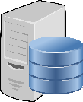


















Layers of Cloud-based IoT
Remote Cloud-based
processing
Proxy
Storage
Processing
Connectivity nodes &
Embedded processing
Sensing and smart devices
Notes:
Analogy of wisdom

Slide 12
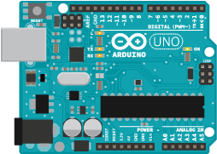
Sensing and Smart Devices
IoT Devices
  Sensors and actuators
  Motion, Temp, Light, Open/Close, Video,
  Reading, Power on/off/dimm etc.
Communication protocols
  Wireless and wired
  Protocols such as ZigBee, Z-Wave, Wi-Fi/Wi-Fi Direct, Bluetooth etc.
  Network congestion is a challenge
Arduino & Raspberry PI
  For rapid prototyping
Notes:
ZigBee is an IEEE 802.15.4-based specification for a suite of high-level communication protocols used to create personal area networks with small, low-power digital radios.
The technology defined by the ZigBee specification is intended to be simpler and less expensive than other wireless personal area networks (WPANs), such as Bluetooth or Wi-Fi. Applications include wireless light switches, electrical meters with in-home-displays, traffic management systems, and other consumer and industrial equipment that requires short-range low-rate wireless data transfer.
----------------------------
ULE
ULE addresses Ultra-Low Energy application requirements by introducing optimized communication methods. Identified with low power consumption, low latency, long range, moderate data rate and value-added complementary voice capabilities, ULE is the best-of-class technology which represents the next evolution in home networking.
ULE is based on DECT (Digital Enhanced Cordless Telecommunications) which is the de-facto standard for residential and business cordless phone communications worldwide.
-----------------------------------
Z-Wave is a wireless technology that makes regular household products, like lights, door locks and thermostats "smart". Z-Wave products "talk" to each other wirelessly and securely and can be accessed and controlled on your phone, tablet or pc.
---------------------------------
The EnOcean technology is an energy harvesting wireless technology used primarily in building automation systems, and is also applied to other applications in industry, transportation, logistics and smart homes. Modules based on EnOcean technology combine micro energy converters with ultra low power electronics, and enable wireless communications between batteryless wireless sensors, switches, controllers and gateways.
In March 2012, the EnOcean wireless standard was ratified as the international standard ISO/IEC 14543-3-10.^{[1]} The standard covers the OSI (Open Systems Interconnection) layers 1-3 which are the physical, data link and networking layers.
The energy harvesting wireless modules are manufactured and marketed by the company EnOcean which is based in Oberhaching, Germany. EnOcean offers its technology and licenses for the patented features within the EnOcean Alliance framework.
------------------------
The Raspberry Pi is a series of credit card–sized single-board computers developed in Pencoed, Wales by the Raspberry Pi Foundation with the intention of promoting the teaching of basic computer science in schools and developing countries.^{[6][7][8]} The original Raspberry Pi and Raspberry Pi 2 are manufactured in several board configurations through licensed manufacturing agreements with Newark element14 (Premier Farnell), RS Components and Egoman.^{[9]} The hardware is the same across all manufacturers.
All Raspberry Pis include a CPU with either an ARMv6-compatible core or newer ARMv7 cores and have included on a chip with VideoCore IV GPU,^{[10]} and have at 256 megabytes of RAM, except later models (models B and B+) that have 512 MB,^{[3][11]} and the Pi 2 at 1 GB. They have Secure Digital (SD) (models A and B) or MicroSD (models A+ and B+) sockets for boot media and persistent storage.
-------------------------------
Arduino is an open-source computer hardware and software company, project and user community that designs and manufactures microcontroller-based kits for building digital devices and interactive objects that can sense and control objects in the physical world.^{[1]}

Slide 13
Gateway/Connectivity Nodes
Primarily deals with the sensor data acquisition and provisioning
Embedded processing saves the communication latencies
Predictive analytics
  Collect data only occasionally
Mobiles can also participate
  This brings in the scope of mobile web services and mobile cloud services for IoT

Slide 14
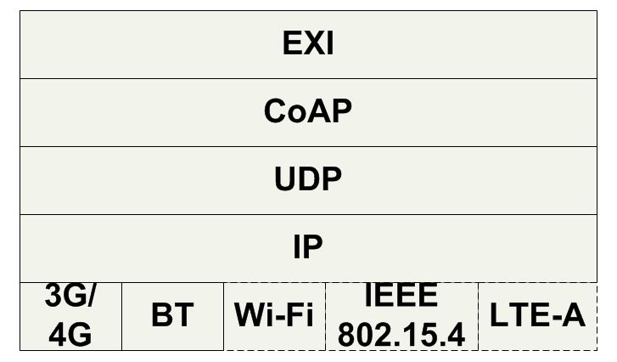
Light-weight Mobile Hosts for Sensor Mediation
It is possible to provide services from smart phones [Srirama et al, ICIW 2006; Srirama, 2008]
Mobile Host can directly provide the collected sensor information
  Data can be collected based on need
Ideal MWS Protocol Stack
  Things have improved significantly over the years
  Bluetooth Low Energy (BTLE) for local service discovery and interaction
  UDP instead of TCP
  Constrained Application Protocol (CoAP)
  Efficient XML Interchange (EXI)
[Liyanage et al, MS 2015]
Notes:
3G/4G mobile Internet for global service interaction
Wi-Fi/Wi-Fi Direct, Bluetooth (BT)/BTLE, IEEE 802.15.4(e.g., ZigBee), or LTE-A (LTE Direct) for local service interaction
LTE Advanced is a mobile communication standard and a major enhancement of the Long Term Evolution (LTE) standard. It was formally submitted as a candidate 4G system to ITU-T in late 2009 as meeting the requirements of the IMT-Advanced standard, and was standardized by the 3rd Generation Partnership Project (3GPP) in March 2011 as 3GPP Release 10.^{[1]}
Bluetooth Low Energy (BTLE) for local service discovery and to collect data from external environmental sensors
BTLE Advertising Packet has the data which can be utilized by the client devices without an established connection
UDP instead of TCP
UDP has a simple header (20 Bytes)
UDP doesn’t maintain connected sessions over the time
--------------
Constrained Application Protocol (CoAP)
Built on top of the User Datagram Protocol (UDP)
Significantly lower overhead (4 byte header size )
Multicast support contrast to the TCP
Including REST methods as GET, POST, PUT and DELETE
End-points use the Constrained RESTful Environments (CoRE) Link Format for the service discovery
Example: coap://myserver.com:5683/.well-known/core
Efficient XML Interchange (EXI)
"schema-informed" compression
The binary compression on the CoAP payload has more compression rate over XML

Slide 15
Limitations with Mobiles
Longer battery life
  Battery lasts only for 1-2 hours for continuous computing
Same quality of experience as on desktops
  Weaker CPU and memory
  Storage capacity
Still it is a good idea to take the support of external resources
  For building resource intensive mobile applications
  Brings in the scope for cloud computing

Slide 16
Mobile Cloud
Harness cloud computing resources from mobile devices
Binding models
  Task delegation [Flores and Srirama, JSS 2014]
    Follows traditional SOA (Service Oriented Architecture) model to
    invoke cloud services
  Mobile code offloading [Flores et al, IEEE Communications Mag 2015; Zhou et al, TSC 2017]
    Offload to a cloud based surrogate based on system and code profilers input
Ideal Mobile Cloud based system should take advantage of some of the key intrinsic characteristics of cloud efficiently
  Elasticity & AutoScaling
  Utility computing models
  Parallelization (e.g., using MapReduce)

Slide 17
IoT Data Processing on Cloud
Enormous amounts of unstructured data
  In Zetabytes (10²¹ bytes) by 2020 [TelecomEngine]
  Has to be properly stored, analysed and interpreted
  and presented
Big data acquisition and analytics e.g. with MapReduce [Srirama et al, FGCS 2012]
In addition to big data, IoT mostly deals with big streaming data
  Message queues such as Apache Kafka to buffer and feed the data into stream processing systems such as Apache Storm
  Apache Spark streaming
Notes:
The data from single sensor could be not more than some MBs per year however; cumulative data from all deployed sensors can scale up and reach in gigabytes or petabytes depending upon the speed of deployment.
Message queues such as Apache Kafka can be used to buffer and feed the data into stream processing systems such as Apache Storm or to leverage the stream part of generic engines such as Apache Spark.
http://www.telecomengine.com/article/intelligent-data-handling-success-mantra-iot
Digital forgetting

Slide 18
Issues with Cloud-centric IoT
Latency issues for applications with sub-second response requirements
  Health care scenarios
  Smart cities and tasks such as surveillance need real-time analysis with strict deadlines
Network load
Certain scenarios do not let the data move to cloud
  Better security and deeper insights with privacy control

Slide 19
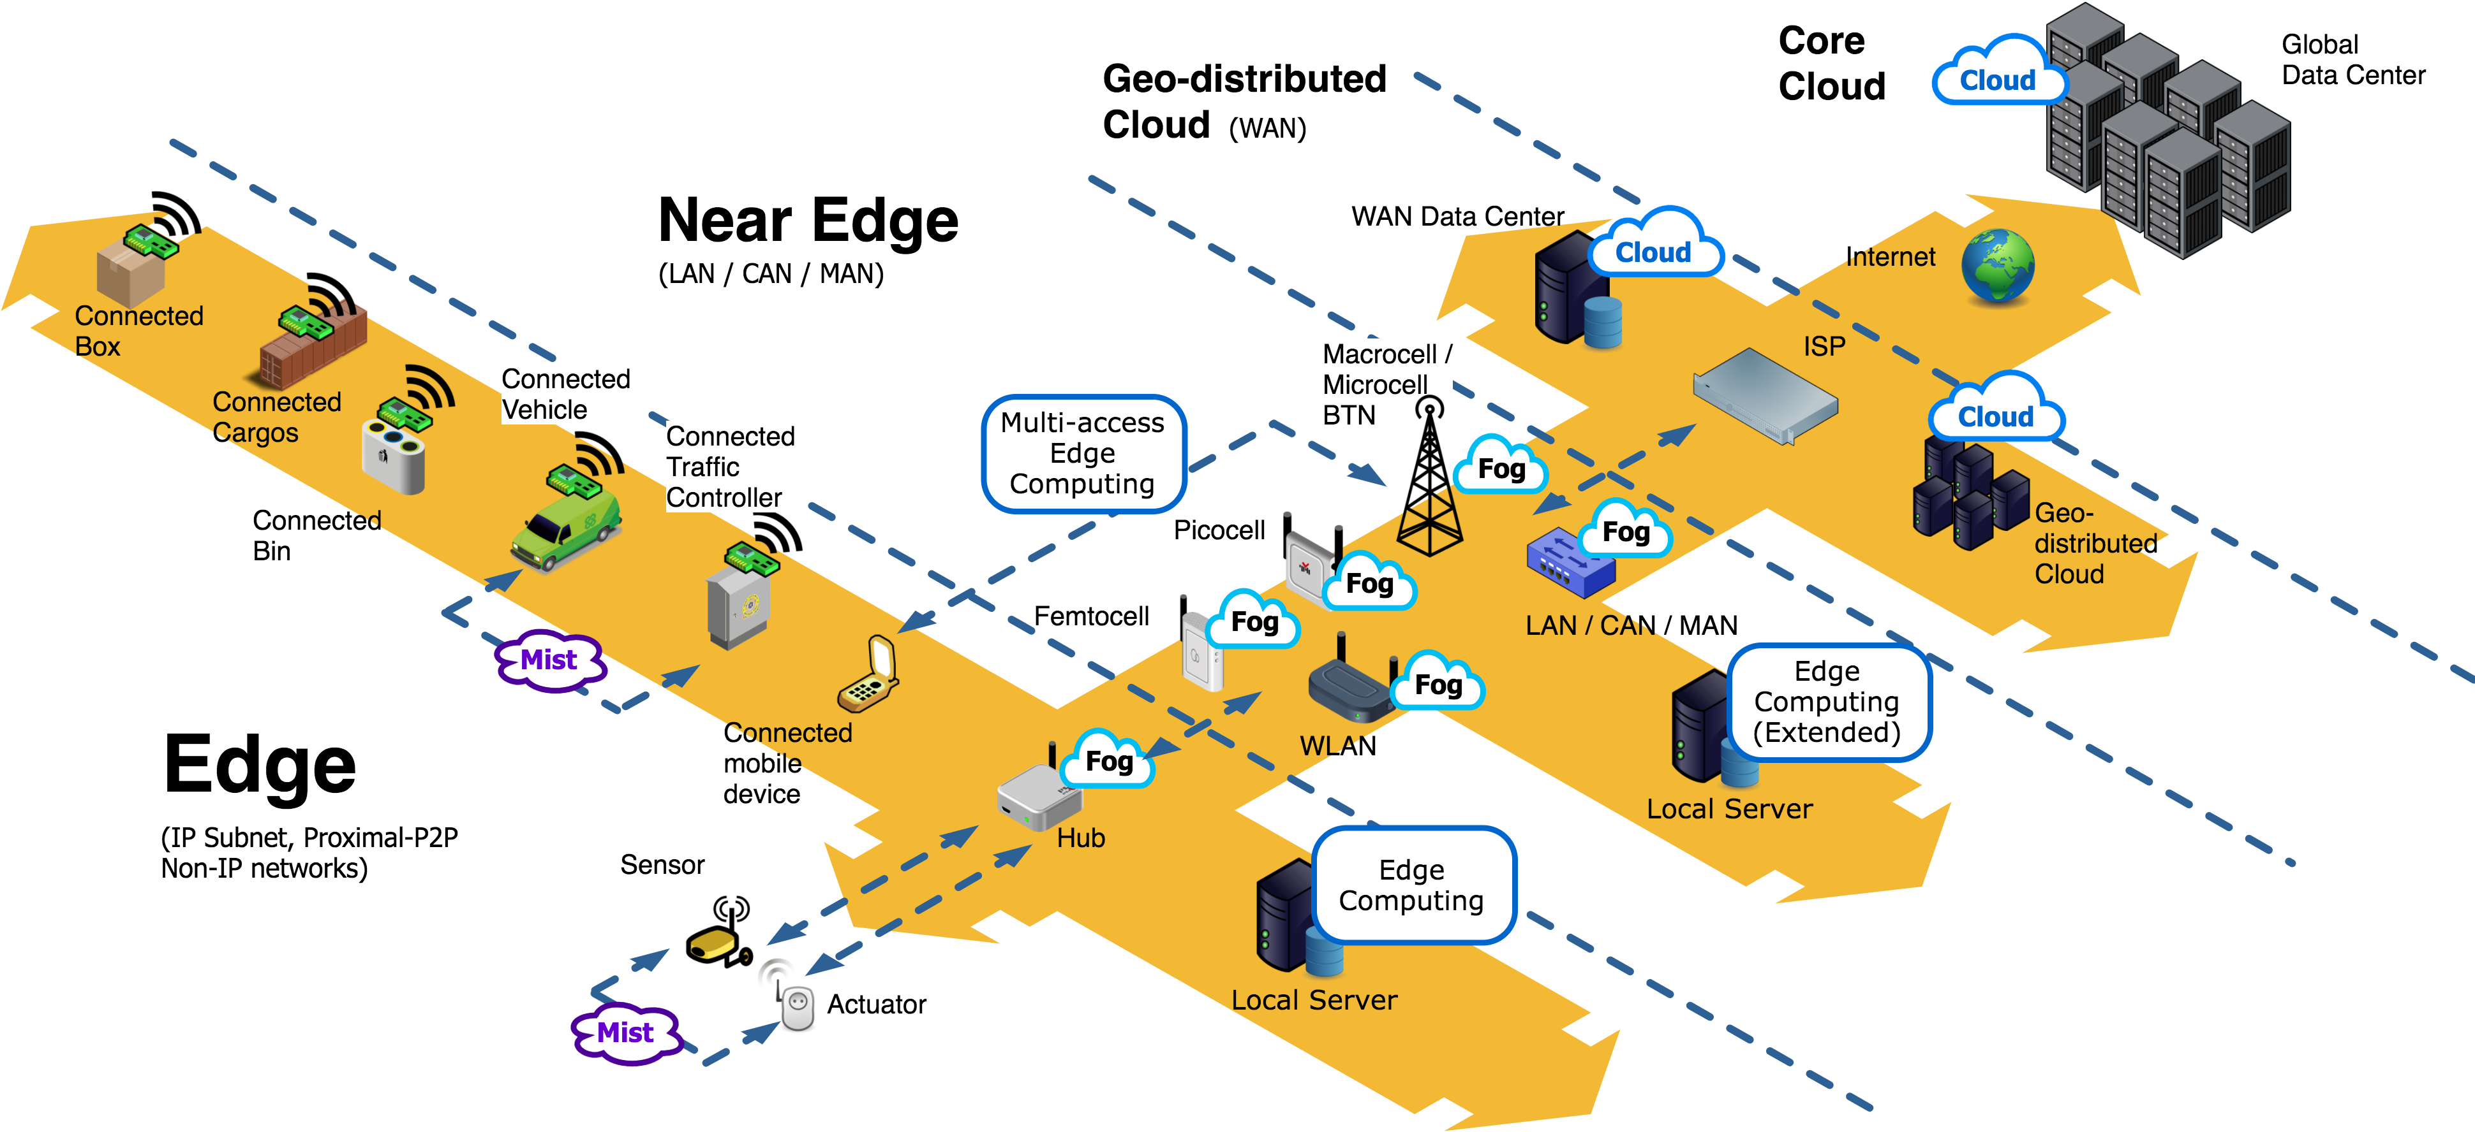
Fog Computing
Processing across all the layers, including network switches/routers
[Chang et al, AINA 2017; FEC 2019; Mass et al, SCC 2016; Liyanage et al, PDCAT 2016]

Slide 20
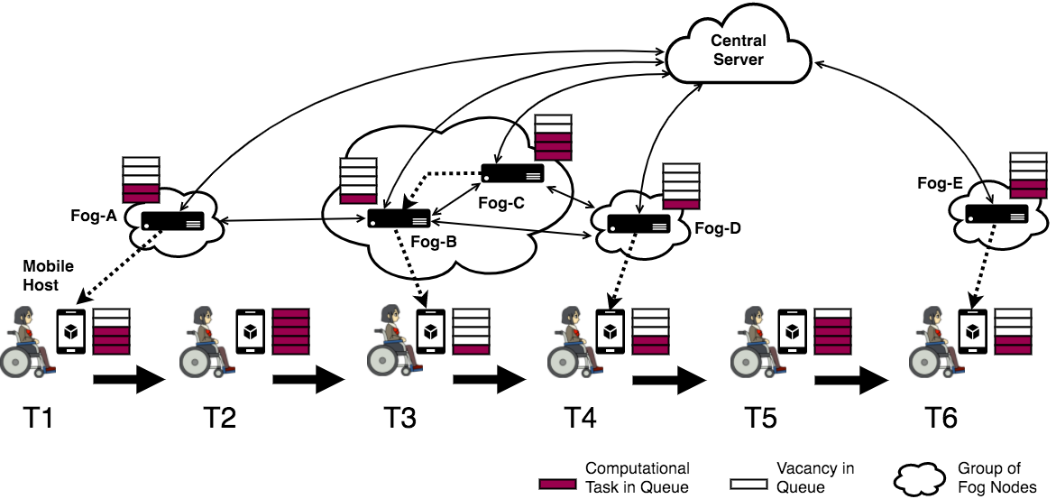
Fog Computing – Research Challenges
Proactive Fog computing using resource-aware work-stealing
Indie Fog [Chang et al, IEEE Computer 2017]
  System architecture for enabling Fog computing with customer premise equipment
  [Soo et al, IJMCMC 2017]
Notes:
Bag of tasks model..
Mobility dealing with disabled person trying to avoid crowded streets.. Need to discover noise sensors.

Slide 21
Fog Computing – Research Challenges - continued
Dynamic Fog computing service discovery and accessing
Distributed and fault-tolerant execution of Fog computing applications
  Based on Actor programming model
  Have implemented applications using tha Akka framework
Notes:
Bag of tasks model..
Mobility dealing with disabled person trying to avoid crowded streets.. Need to discover noise sensors.

Slide 22
Fog Computing – Research Challenges - continued
QoS & QoE-aware application placement across Fog topology [Mahmud et al, JPDC 2019; JPDC 2020]
  Resource intensive tasks of IoT applications can be placed across the Fog topology
  Latency and cost-aware application module management
The problem can also be formulated as multi-objective offloading strategy [Adhikari et al, IEEE IoTJ 2019]
  Latency and resource management
  Need to consider the types of the jobs and their priority
  Need to find ideal heuristics, metaheuristics etc.
  Also have to consider the graph topology of the Fog nodes
QoS – Quality of Service
QoE – Quality of Experience
Notes:
Multilevel-feedback priority queueing model

Slide 23
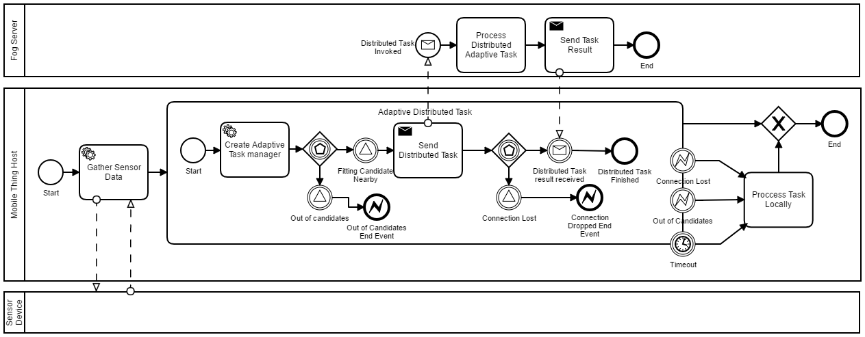
Fog Computing – Research Challenges - continued
Process-driven Edge Computing in Mobile IoT [Mass et al, IoTJ 2019; CASA 2018; Chang et al, CSUR 2016]

Slide 24
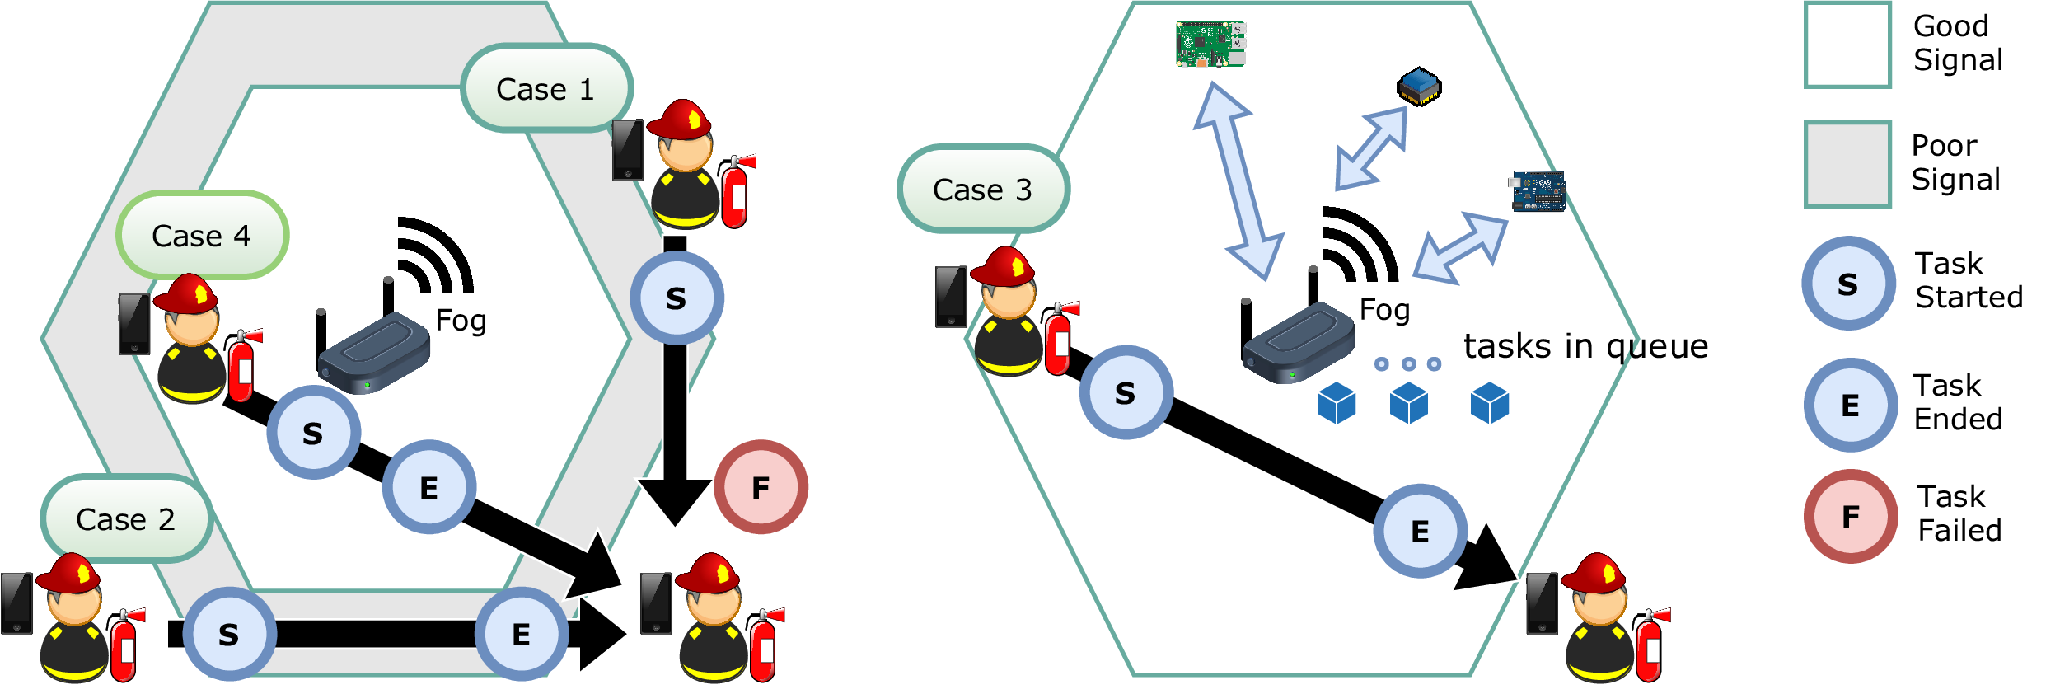
Fog Computing – Research Challenges - continued
Mobility also becomes critical in Fog computing [Mass et al, IoTJ 2019]
STEP-ONE : Simulated Testbed for Edge Processes based on the Opportunistic Network Emulator
  Extended the ONE simulator to simulate the Fog computing mobility aspects
  Process execution based on Flowable BPMS

Slide 25
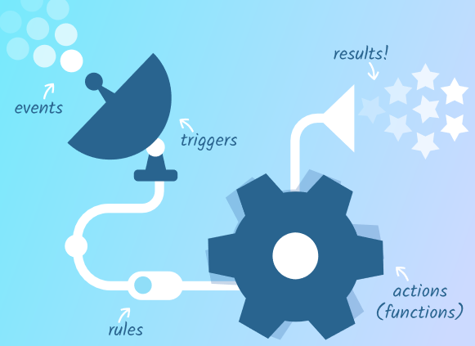

Serverless computing
Event-action platforms to execute code in response to events
Applications are charged by compute time (millisecond) rather than by reserved resources
IoT workloads are a better fit for event driven programming
  Execute app logic in response to sensor data
  Similar tasks
    Execute application logic in response to database triggers
    Execute app logic in response to scheduled tasks etc.
Serverless computing is ideal solution for fog processing
  OpenFaaS, light-weight enough to place on Raspberry Pi

Slide 26

EU H2020 -RADON
Rational decomposition and orchestration for serverless computing
  Jan 2019 – Jun 2021
Goal
  Creating a DevOps framework to create and manage microservices-based applications
  Tools that facilitate in designing and orchestrating data pipeline applications that involve serverless entities
  OASIS - Topology and Orchestration Specification for Cloud Applications (TOSCA)
Case studies
  IoT application from healthcare
  Tourism
Integration of cloud, IoT and Big Data analytics
  Facilitated through data pipeline solutions such as Apache Nifi

Slide 27
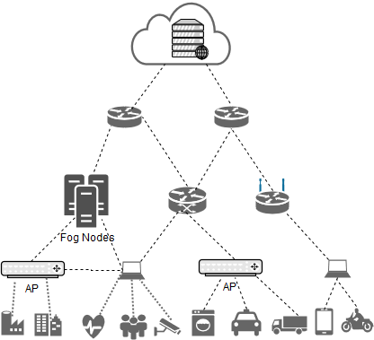
Research Roadmap – IoT & Fog Computing
Distributed data processing on the Cloud
E.g. MapReduce, Spark
Cloud
Distributed data processing across the Cloud and Fog layers
E.g. Personalized data, privacy etc.
Core Network
Fog topology management and scheduling the tasks
E.g. tasks run across the fog topology such as stream data processing, smart streetlights etc.
Edge Nodes
Fog
Edge analytics
E.g. filter, error detection, consolidation etc.
Gateways
Intelligent sensors
E.g. vehicular networks
End points
Notes:
Our research progresses based on this big umbrella
“The most profound technologies are those that disappear. They weave themselves into the fabric of everyday life until they are indistinguishable from it.” This statement in Mark Weiser’s well-known “The Computer for the Twenty-First Century” (Scientific American, 1991, pp. 66–75) has been a source of inspiration for many and still is an important guideline for the work in the Smart Future Initiative.
Weiser is widely considered to be the father of ubiquitous computing, a term he coined in 1988.

Slide 28
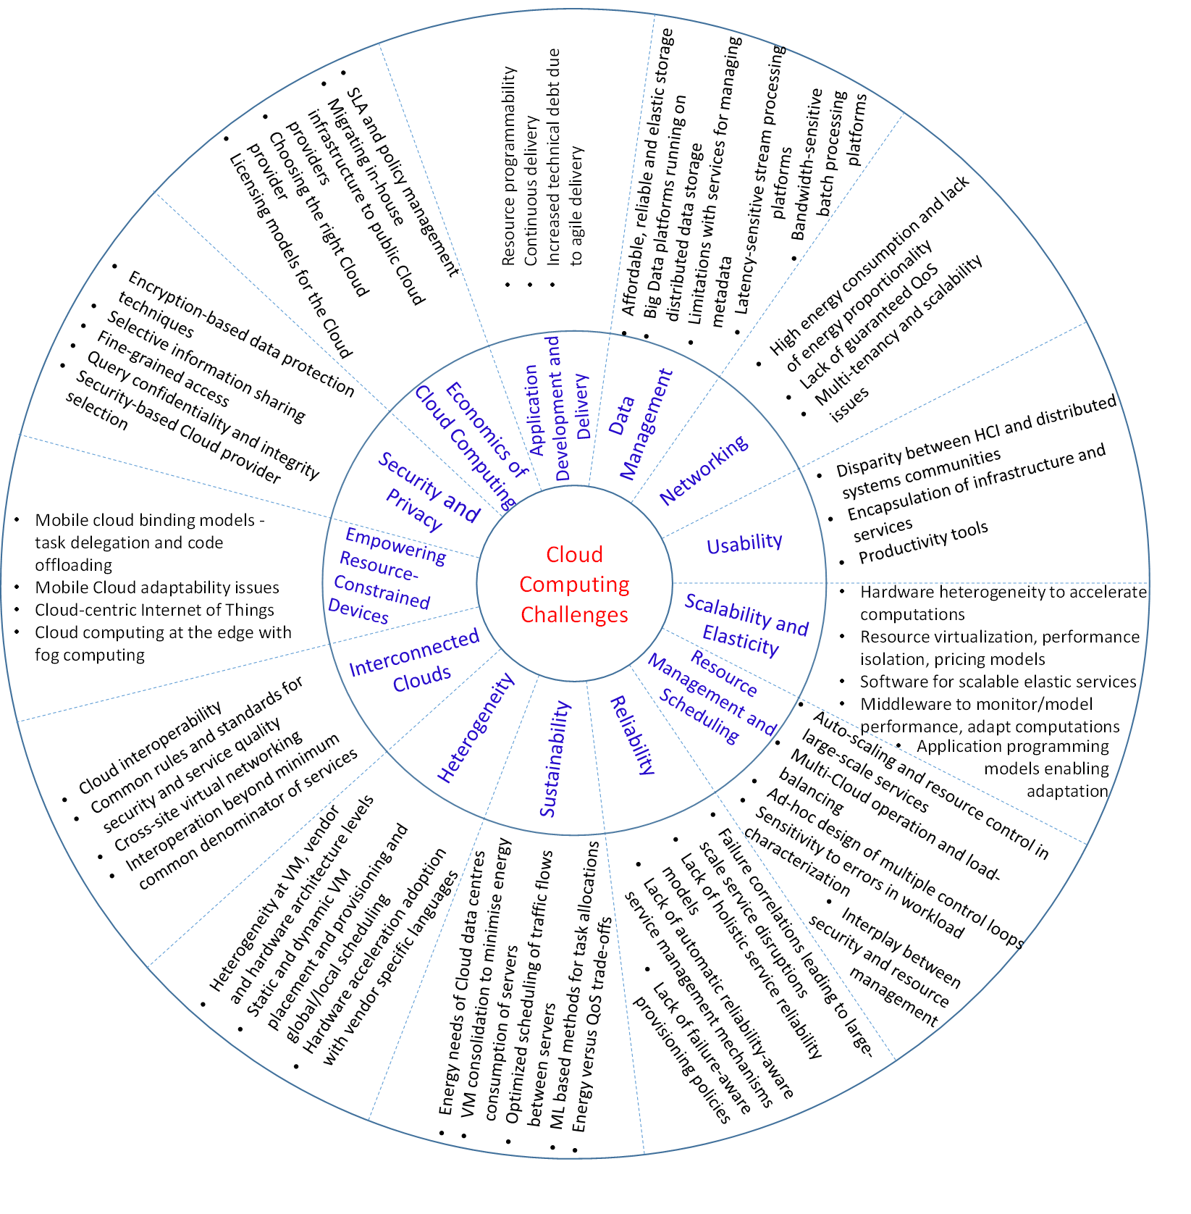
A Manifesto for Future Generation Cloud Computing: SOA and Challenges
  [Buyya, Srirama, Casale et al,
  ACM CSUR 2019]

Slide 29
Emerging trends and impact areas for cloud
Containers
Fog Computing
Big Data
Serverless Computing
Software-defined Cloud Computing
Blockchain
Machine and Deep Learning

Slide 30
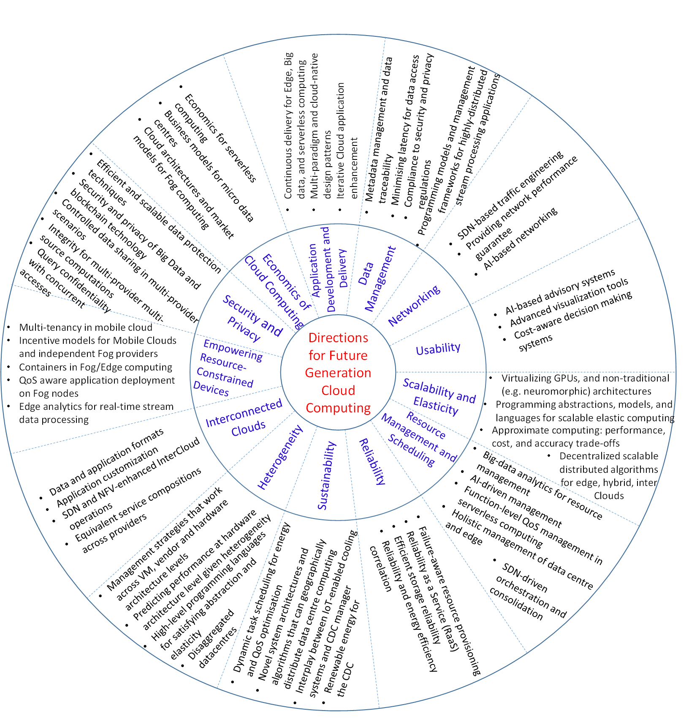
A Manifesto for Future Generation Cloud Computing: Research Directions for the Next Decade
  [Buyya, Srirama, Casale et al,
  ACM CSUR 2019]

Slide 31
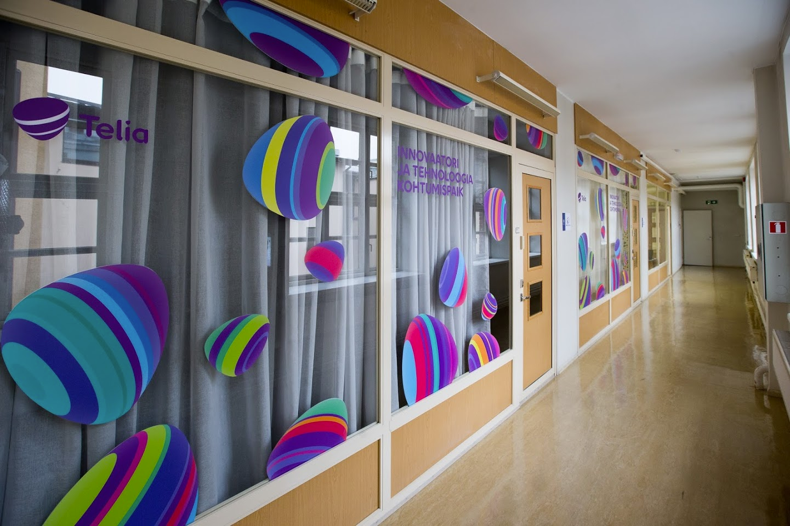
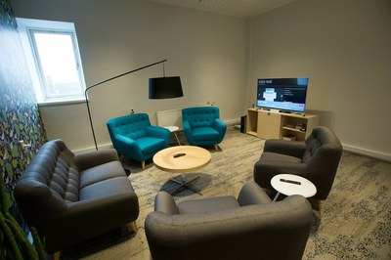
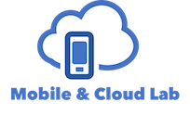

IoT and Smart Solutions Laboratory

Slide 32

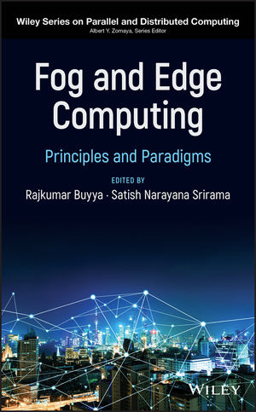

Thank you for your attention
srirama@ut.ee

