Slide 1
Choosing predictor variables in a linear model: making use of DAGs
V46 StatisticsCorner
Ants Kaasik
TARTU

Slide 2
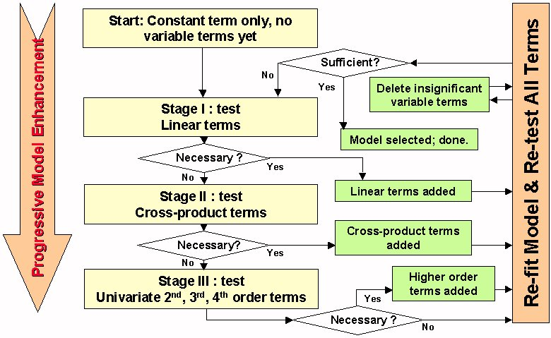
Building a statistical model (e.g. LMM)
We usually have several predictors
What predictors variables should we include?
Perhaps we should use model selection (model comparison)?
Source: https://en.wikipedia.org/wiki/Stepwise_regression

Slide 3
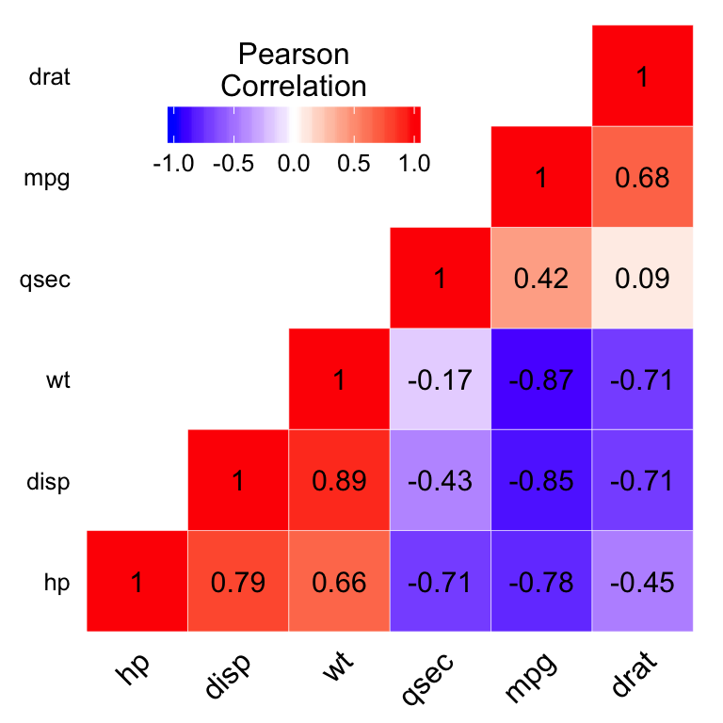
Basics 1: multicollinearity
Standard errors of coefficients increase
Interpretation of coefficients obviously impossible
Prediction is unharmed
Source: http://www.sthda.com/english/wiki/ggplot2-quick-correlation-matrix-heatmap-r-software-and-data-visualization

Slide 4
Basics 2: omitted variables
Adding omitted variables can improve estimate precision
Regression coefficients become unbiased (if predictor variables are correlated)
TREATMENT
WEIGHT
LENGTH

Slide 5
Basics 3: Post-treatment bias
Adding post-treatment variables will hide the effect of treatment
Regression coefficient for treatment will not be interpretable
Model selection will favor post-treatment variables
TREATMENT
HEALTHY
FITNESS

Slide 6
Direct vs indirect effect
In certain situations it might be reasonable to include post-treatment variables
TREATMENT
HEALTHY
FITNESS

Slide 7
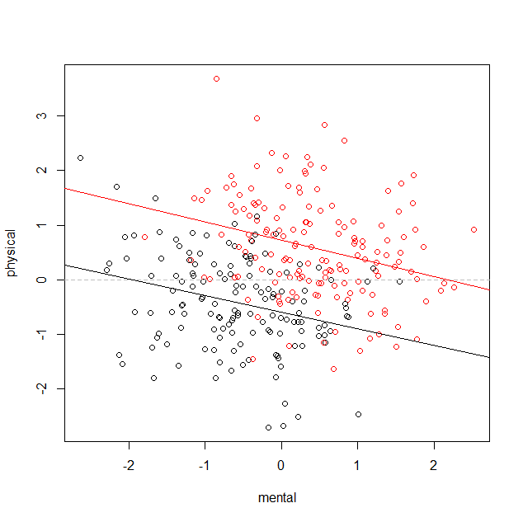
MENTAL CAPABILITY
PHYSICAL CAPABILITY
Collider bias
Conditioning on a „dependent“ variable causes spurious correlations
Thus selection can distort regression coefficients
SURVIVAL
mental=rnorm(300)
physical=rnorm(300)
survival=rbinom(300,1,plogis(2*mental+2*physical))

Slide 8
DAG: directed acyclic graph
Interested in the direct effect of X on Y. Should we include Z?
X
Y
X
Y
X
Y
Z
Z
Z
A) FORK
B) CHAIN (or PIPE)
C) COLLIDER
Yes for A). Yes for B). No for C).

Slide 9
Direct vs indirect effect (2)
In certain situations it might be reasonable to include post-treatment variables
But things can get complicated when we encounter unmeasured variables
Now one flow is closed but another is opened
TREATMENT
HEALTHY
ENVIRONMENT
(NOT MEASURED)
FITNESS

Slide 10
Direct vs indirect effect (3)
TREATMENT
HEALTHY
ENVIRONMENT
(NOT MEASURED)
FITNESS
treatment=rep(c(0,1),each=150)
envir=rbinom(300,1,0.5)
healthy=rbinom(300,1,0.3 + treatment*0.3 + envir*0.4)
fitness=rnorm(n,healthy+2*habitat)
m1=lm(fitness~treatment+healthy)

Slide 11
Direct vs indirect effect (4)
TREATMENT
HEALTHY
ENVIRONMENT
(NOT MEASURED)
FITNESS
Why does knowing treatment proovide information about fitness when we already know the health?
Because e.g. when treatment was not applied but organism is healthy then this is probably because of positiive environment effect and thus we also expect higher fitness

Slide 12
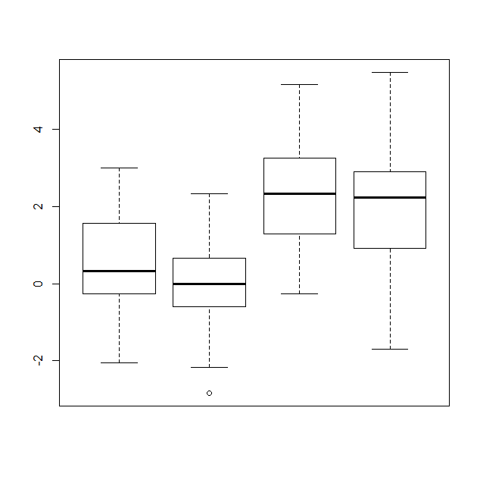
Direct vs indirect effect (5)
Not treated
Treated
Indeed, given health status, treatment seems to lead to a drop in fitness median
Not healthy
Healthy

Slide 13
Descendants
X
Y
X
Y
X
Y
Z
Z
Z
D
D
D
A) FORK
B) CHAIN (or PIPE)
C) COLLIDER
Quite often we have not measured the possible predictor directly but only have a descendant of it available for consideration
Conditioning on it has a similar (but smaller) effect as conditioning on the actual predictor

Slide 14
Examples
Interested in the direct effect of X on Y.
What predictors should we include?
Z
Y
X
A
It is enough to condition on Z as this blocks both indirect paths.

Slide 15
Examples (2)
Interested in the direct effect of X on Y.
What predictors should we include?
A
U
B
X
Y
As U is unmeasured we need to condition on both A and B to get the direct effect.

Slide 16
Examples (3)
Interested in the direct effect of X on Y.
What predictors should we include?
Z
Y
X
A
Condition on Z as this blocks the upper path. Do not condition on A as this would open the lower path.

Slide 17
Examples (4)
Interested in the direct effect of X on Y.
What predictors should we include?
A
U
B
X
Y
The lower path is blocked by U and cannot be opened. As A is a collider we should not condition on it.

Slide 18
Examples (5)
Interested in the direct effect of X on Y.
What predictors should we include?
A
D
U
X
Y
The best we can do is to condition on both D and A as the first almost blocks the lower path (and thus open the upper) which we block by conditioning on A.

Slide 19
Examples (6)
Interested in the direct effect of X on Y.
What predictors should we include?
X
Z
U
Y
There is no way to close both paths – conditioning on Z block one path but opens another. We cannot estimate the direct effect of X on Y.

Slide 20
Summary
Certain typical situations can easily be handled by DAGs
DAGs are very useful when coefficient of a predictor changes the sign when some additional predictor is added
Creating a DAG also helps in the problem setup
When we are certain that the predictor has no arrow entering it then we can definitely include it
Otherwise it is not clear-cut

Slide 21
Thank you for the attention!

