Slide 1
Quantum relational Hoare logic, towards a formalization
Dominique Unruh
University of Tartu

Slide 2
Overview
Quantum relational Hoare logic (qRHL)
Motivation
How to define, etc.
Extensions
Working with qRHL
Our tool
Challenges
Formalizing (in Isabelle/HOL)

Slide 3
Motivation: (Post-)Quantum Crypto
Quantum computers threaten crypto
RSA, ECC, etc. broken
Quantum communication enables better crypto
Security proofs needed!

Slide 4
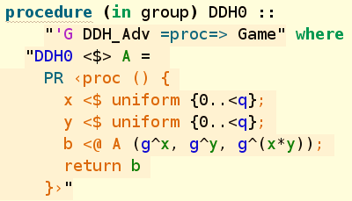
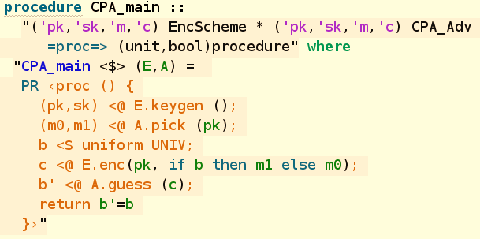
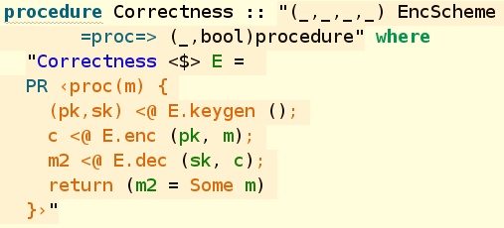
Crypto proofs – bird’s eye view
“Sequences of Games”
(established approach for crypto proofs)
How to prove relationship?
How to find sequence of games?

Slide 5
Verifying game-based proofs: 2 approaches
CryptoVerif approach:
Have a set of pre-proven rewrite rules
Automatically apply them to simplify game
EasyCrypt approach:
User manually writes the games
User manually proves equivalences in “relational Hoare logic”
Hard work, more powerful
(this talk)

Slide 6
Important insight
Crypto verification boils down to reasoning about programs
(E.g., Hoare logics and similar)

Slide 7
Relational Hoare Logic (RHL)
Describes relation of two programs
How do the variables of the two programs relate?
Used, e.g., in EasyCrypt for classical verification (using a probabilistic variant)
$\left\{x=y\right\}$ $x≔x+1 \sim z≔y$ $\{x=z+1\}$

Slide 8
Example derivation
$\left\{x_{1}=x_{2}\right\}$
$x+=1$ $\sim$ $skip$
$\{x_{1}−1=x_{2}\}$
$x+=1$ $\sim$ $skip$
$\{x_{1}−1−1=x_{2}\}$
$skip$ $\sim$ $x+=2$
$\{x_{1}−1−1=x_{2}−2\}$
$=\{x_{1}=x_{2}\}$
$\{x_{1}=x_{2}\}$
$x+=1;x+=1$
$\sim$ $x+=2$
$\{x_{1}=x_{2}\}$

Slide 9
How about quantum?
“Games” may contain quantum vars / quantum operations
Need a quantum version of RHL

Slide 10
Quantum Relational Hoare Logic (qRHL)
Elementary while-language
Quantum variables $X,Y$
What does $X≡Y$ mean?
How to formalize semantics of qRHL?
Subspaces
$\left\{X≡Y\right\}$ $apply U to X$
$\sim apply U to Y$ $\{X≡Y\}$
Main source of trouble: Entanglement
[U, Quantum Relational Hoare Logic, POPL 2019]

Slide 11
Specific Challenges
Equal rule: $\frac{fv\left(c\right)=X}{\left\{X_{1}≡X_{2}\right\} c \sim c \{X_{1}≡X_{2}\}}$ For reasoning about unknown code (adversaries)
Frame rule: $\frac{R independent of c,d \left\{A\right\} c \sim d \{B\}}{\left\{A∩R\right\} c \sim d \{B∩R\}}$ For modular reasoning

Slide 12
Definition of qRHL
$\left\{X=Y\right\}$ $apply U to X$
$\sim apply U to Y$ $\{X=Y\}$
For two quantum states that are marginal of a state satisfying this
After applying these programs
The final states are marginal of some state satisfying this
separable
separable
Without “separable”, cannot prove Frame rule

Slide 13
Definition of qRHL (formal)
$$\left\{A\right\} c \sim d \{B\}$$
subspace of
$$ℋ_{mem}⊗ℋ_{mem}$$
$$⟦c⟧$$
$$ρ_{1}$$
$$ρ_{1}^{′}$$
partial trace
$$∀ρ⊢A$$
$$∃ρ′⊢B$$
separable
partial trace
separable
$$⟦d⟧$$
$$ρ_{2}$$
$$ρ_{2}^{′}$$
i.e., $supp ρ⊆A$

Slide 14
Quantum Equality
Equal rule: $\left\{X_{1}≡X_{2}\right\} c \sim c \{X_{1}≡X_{2}\}$
What does “$X≡Y$” mean?
Quantum variables have no individual content (due to entanglement)
Need definition that is subspace
$|Ψ〉$satisfies $X_{1}≡X_{2}$ iff
$|Ψ〉$invariant under swapping $X_{1}↔X_{2}$

Slide 15
Quick aside: extensions
Quantitative pre-/postconditions (“expectations”)
[Li, Unruh, Quantum Relational Hoare Logic with Expectations, ICALP 2021]
[Barthe et al, Relational Proofs for Quantum Programs, POPL 2020]
Ghost variables
Quantum equality with other program enforces non-entanglement
Idea: Use “hypothetical” second program for extra expressibility (non-entanglement, classicality)
[Unruh, Quantum Hoare Logic with Ghost Variables, LICS 2019]

Slide 16
Using qRHL

Slide 17
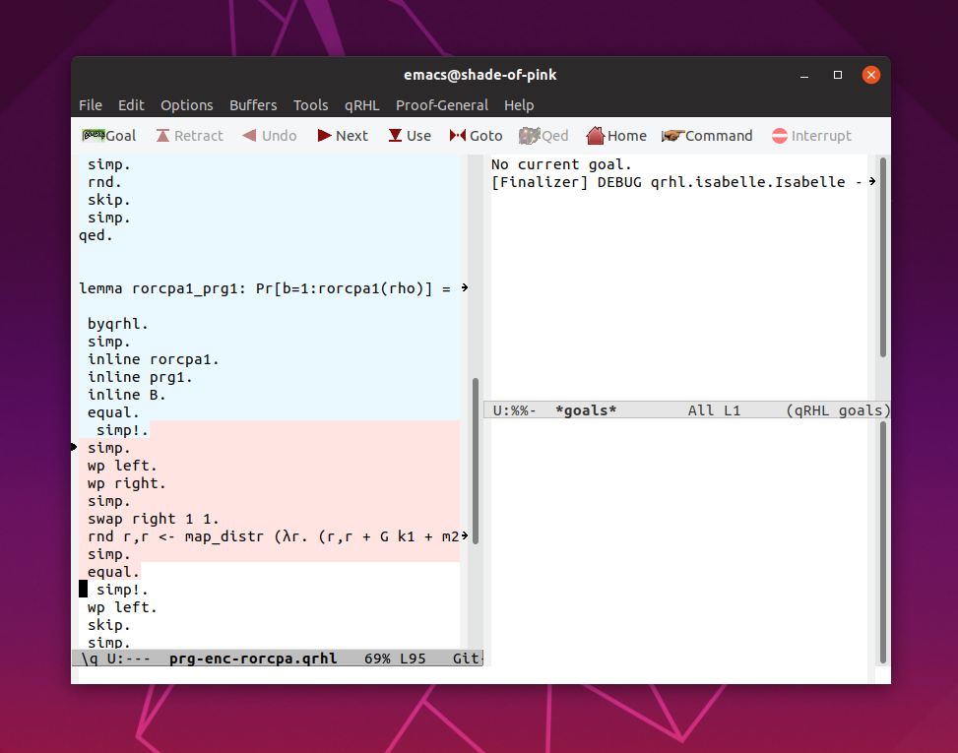
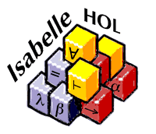
Our Tool
Tactics for qRHL
Verification conditions (VCs): Inequalities of subspaces
[https://tinyurl.com/qrhl-tool]
Backend for representing pre-/postconditions
Reasoning about VCs
Smooth path towards full verification

Slide 18
Challenge: representing assertions
Pre-/postconditions: Arbitrary subspaces of infinite-dimensional Hilbert space
Need usable notation.
`
$$\begin{matrix}ℋ & (x>0) \\ 0 & otherwise\end{matrix}$$
$${span\{|x⟩\}}_{q}⊗ℋ_{all but q}$$
intersection (“and”)

Slide 19
Referring to variables
How to get from to ${span\{|x⟩\}}_{q}⊗ℋ_{all but q}$?
Similarly: m and
What is q? What is ?
How to reason about such “quantum memory locations”?
Not specific to qRHL → relevant for all(?) quantum Hoare logics

Slide 20
Current approach
Variable (q):
Pair of: name (string) and type^{[caveat]}.
Packaged in a type-safe way
Quantum memory:
$\sum_{m}{α_{m}|m⟩}$ for $m∷variable⇒value$

Slide 21
Current approach
Variables ( ):
Roughly speaking: Trees of variables
Lots of trickery for type-safety
Specific definitions for “lifting” operators, spaces, etc.

Slide 22
Experiences
Cumbersome to define and to reason
Reordering variables:
-
Generic reasoning:
- and conceptually different! (qr cannot be instantiated with q,r)
Improvements needed!

Slide 23
Register formalism
Generic concept of memory location (“quantum register”)
Encompasses also tuples of variables etc.
Basic idea:
A “register” abstractly gives a mapping from “small” operators to operators on whole memory
Independent of memory structure
Converting qrhl-tool: work in progress
[U, Quantum and classical registers, arXiv 2021]

Slide 24
Towards full verification
Background theory
Infinite-dim Hilbert spaces & bounded operators (for reasoning about predicates etc.)
Tensor product (also of operators!), for register formalism, w.i.p.
Trace class operators, w.i.p.
Semantics and rules, to be started
Should be “easy” with complete bg theory
[Caballero, U, Complex Bounded Operators, AFP, 2021]

Slide 25
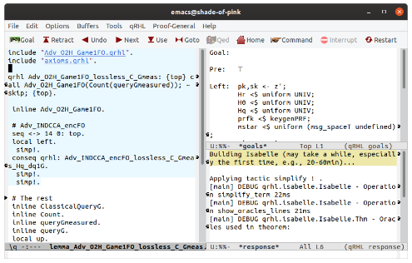
Vision: A Comprehensive Framework
Decision procedures / automation
Logic qRHL
Q protocols/proofs
Q information
Improved logics
Usability
Formalization of HKSU…
Tool
lots
$(Enc,Dec)$ is CCA-secure
Verifying implementations
Formalizing math background

Slide 26
Q?
uestions?
(Or catch me offline…)

Slide 27
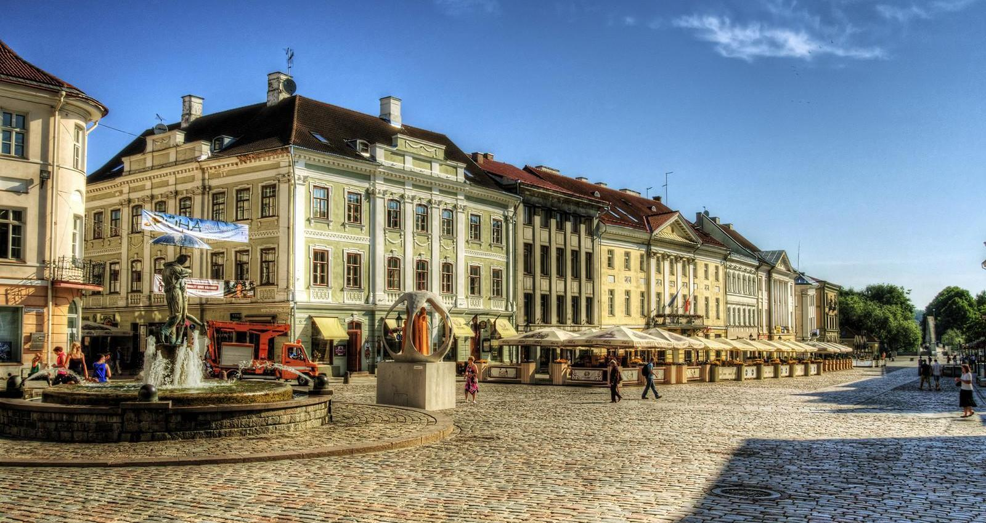
Postdoc/phd at University of Tartu:
Verification of Quantum Cryptography
http://tinyurl.com/postdoc-vqc
Quantum logic?
Thm proving?
Q info-theo/crypto?

