Slide 1
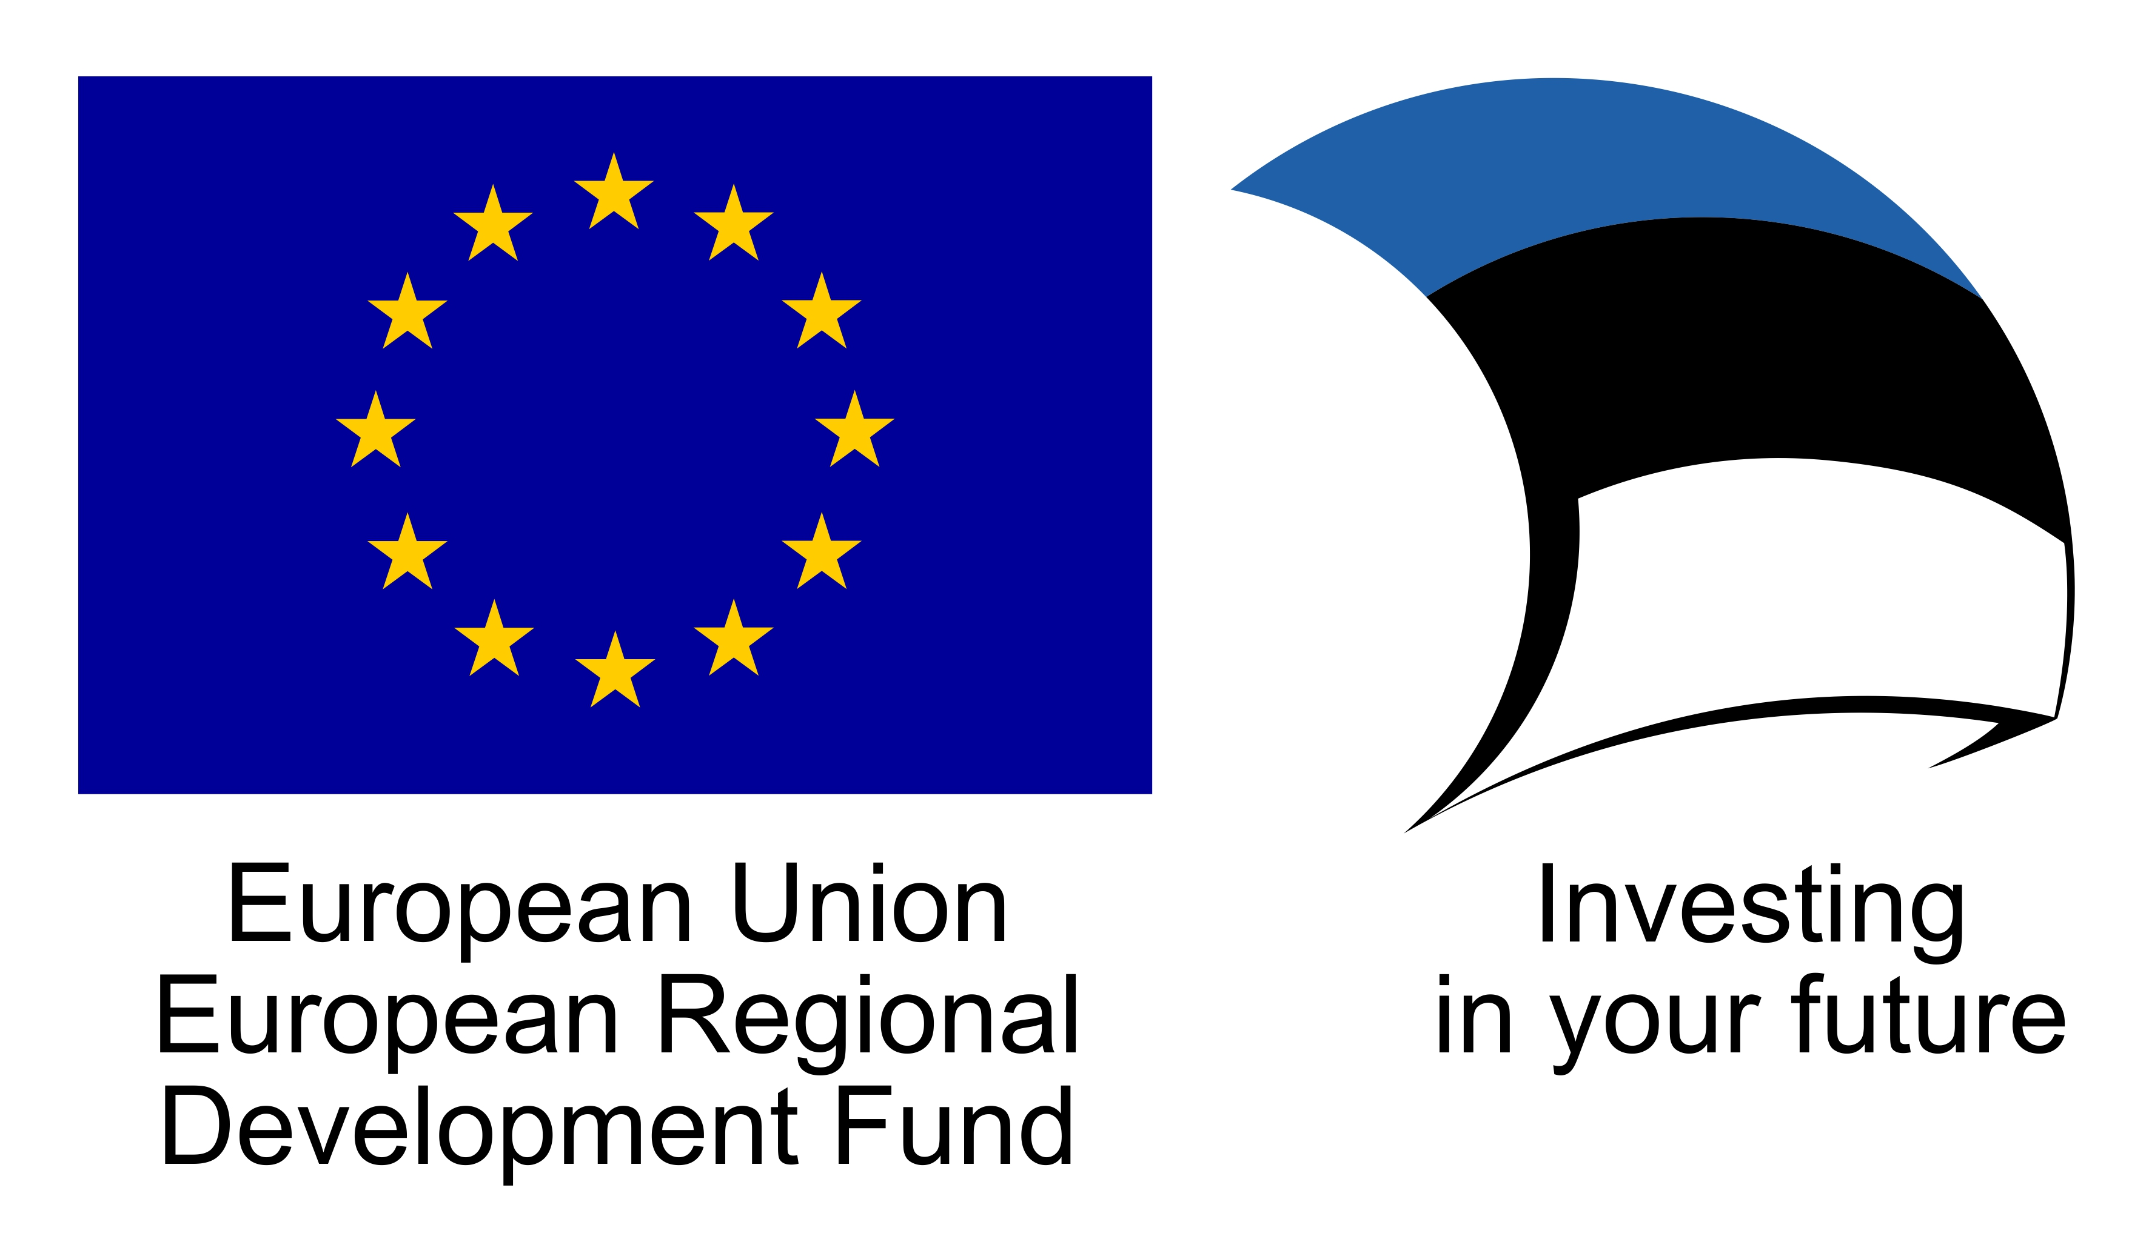
Varieties of chemical composition of Ayahuasca
Helle Kaasik
University of Tartu, Estonia
helle.kaasik@ut.ee

Slide 2
What is ayahuasca?

Slide 3
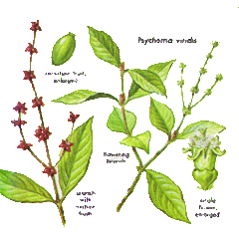
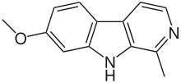
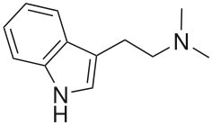
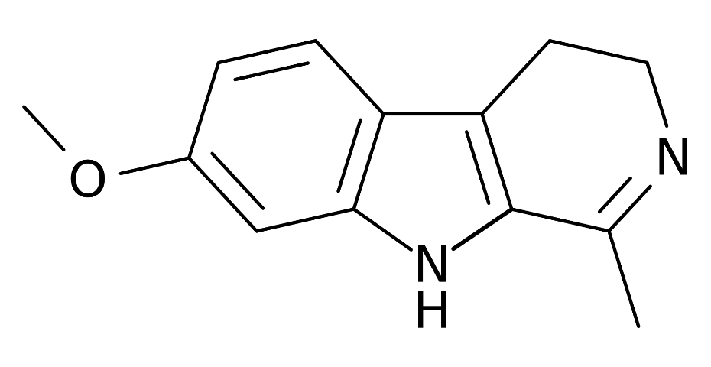
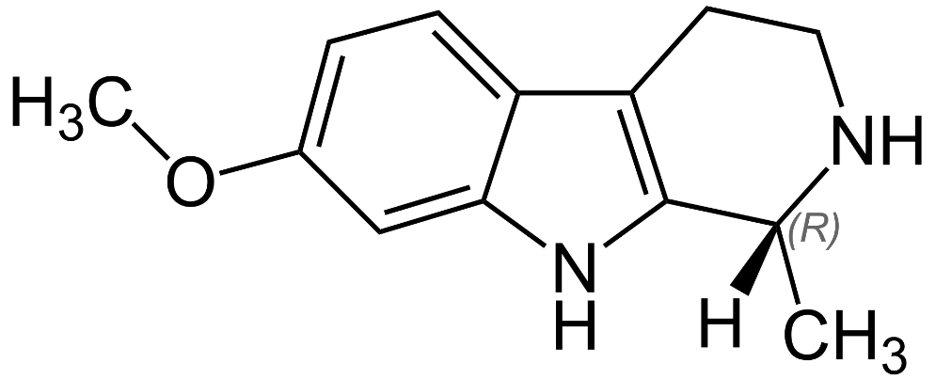
Banisteriopsis caapi vine stems + Psychotria viridis leaves:
MAO-A inhibitors (harmine, harmaline) N,N-dimethyltryptamine (DMT)
tetrahydroharmine
Psychedelic effect: visions, changed feeling and thinking , mystical experiences
Physical effects

Slide 4
Ayahuasca additives and analogues
Traditional admixture plants – to modify the effects
Analogues – substitutes for the main constituents
“anahuasca” from other plants, e.g. Peganum harmala, Mimosa tenuiflora
“pharmahuasca” with extracted or synthetic MAOI + DMT

Slide 5
Use of ayahuasca
Amazonian indigenous ceremonies for healing and divination
Sacrament for Brazilian syncretic religions
Ayahuasca rituals as a worldwide practice of new spirituality

Slide 6
Santo Daime feitio – ritual cooking of the sacrament

Slide 7
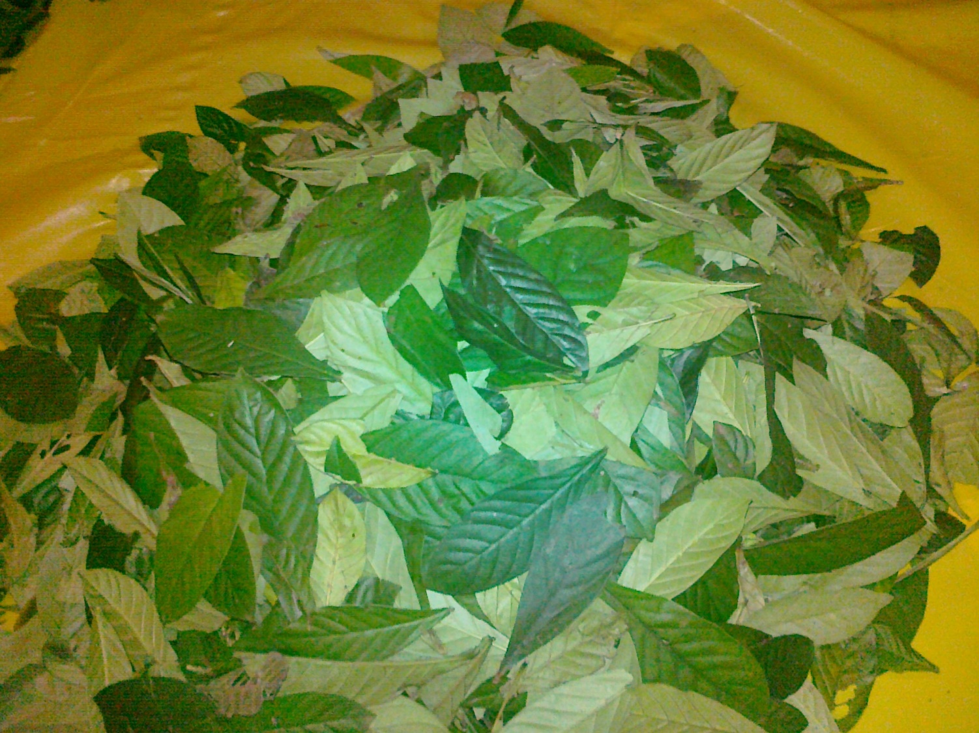

Slide 8
Research journey into chemical composition of ayahuasca
Chemical analyses of 102 ayahuasca samples from different countries and traditions

Slide 9
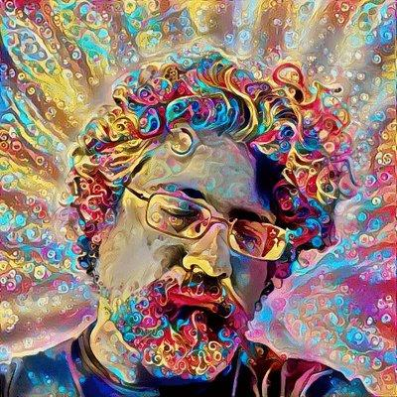
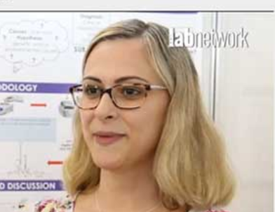
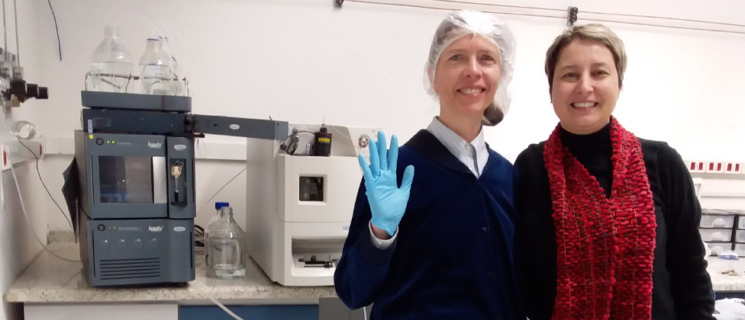
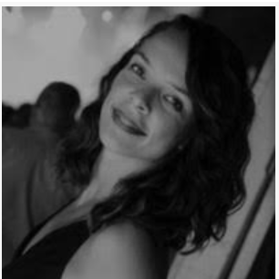
Our Brazilian team
Luís Fernando Tófoli
Alessandra Sussulini
Rita C. Z. Souza
Flávia S. Zandonadi

Slide 10
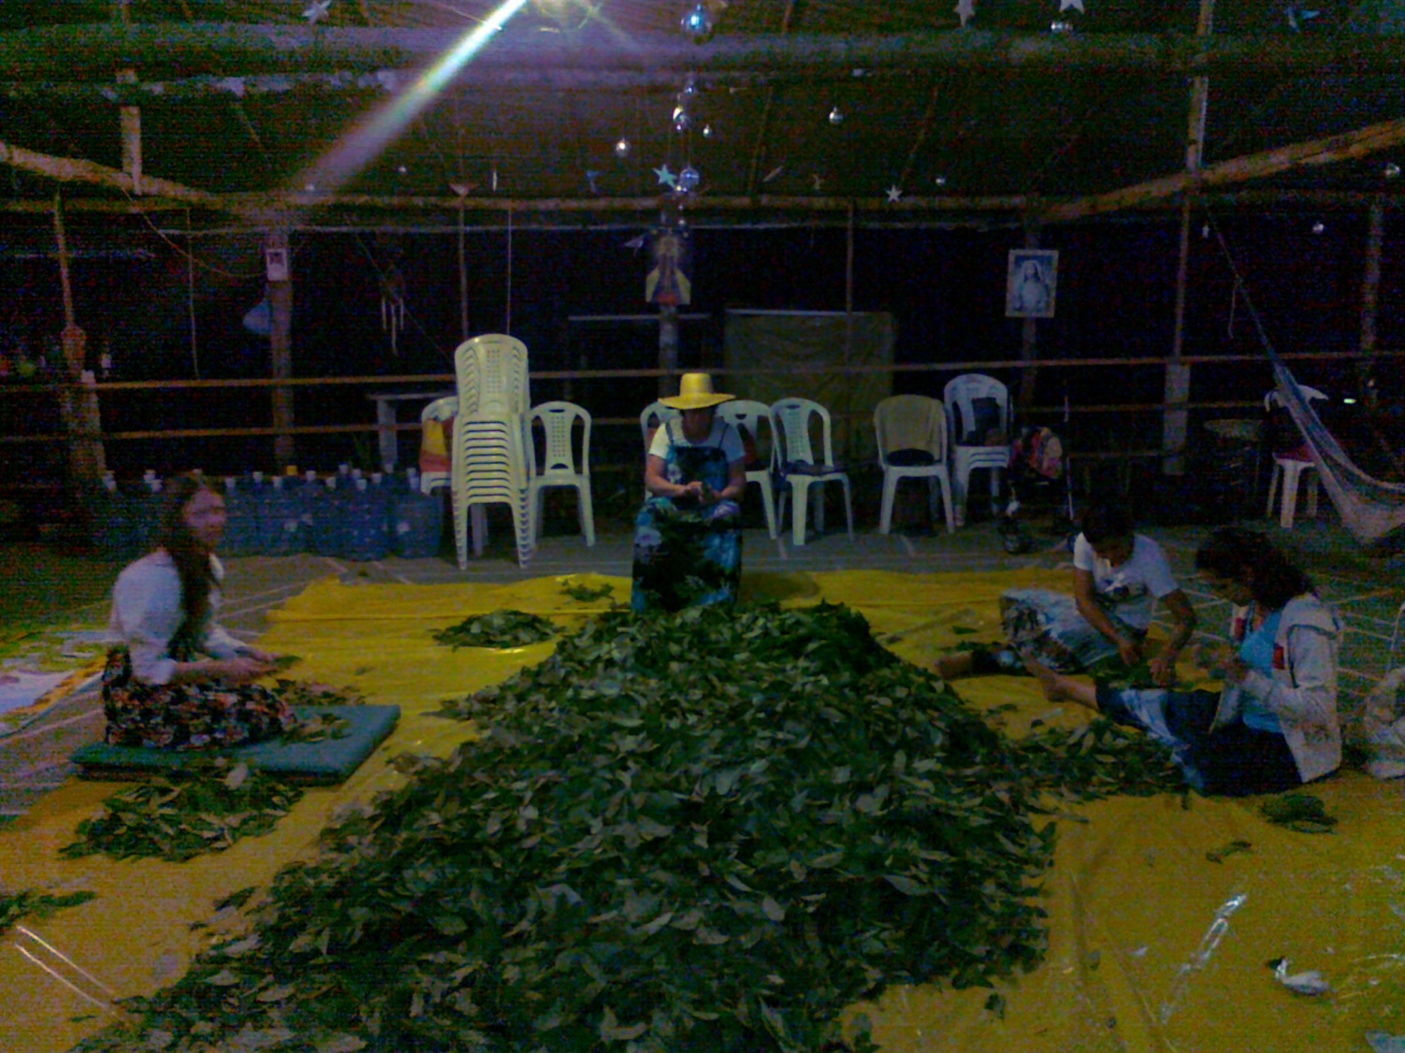

Slide 11
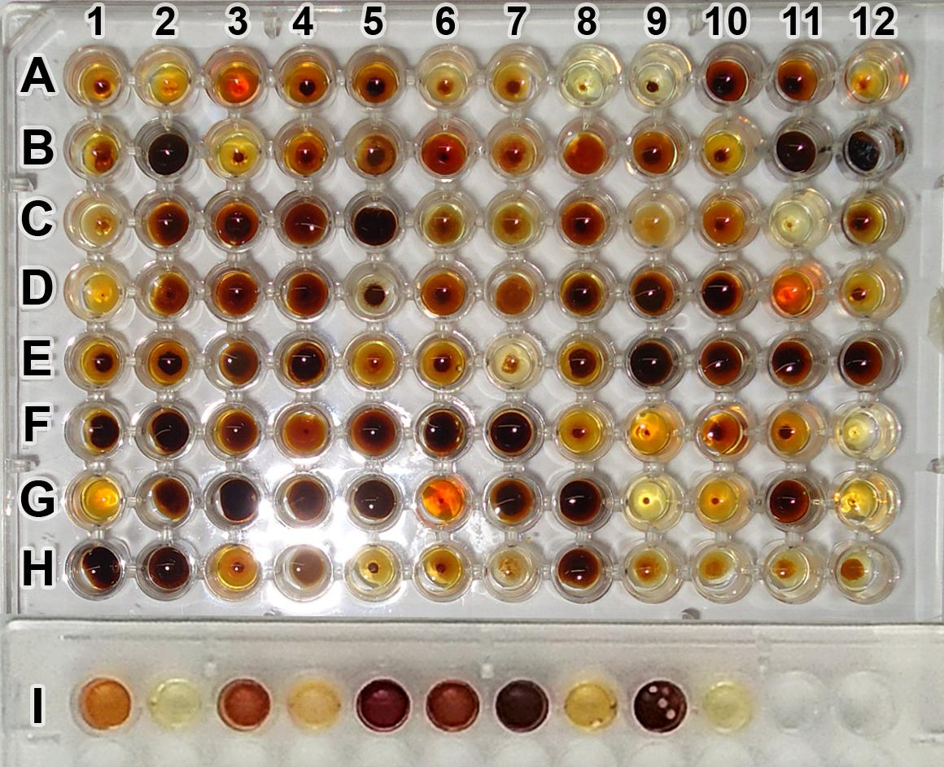
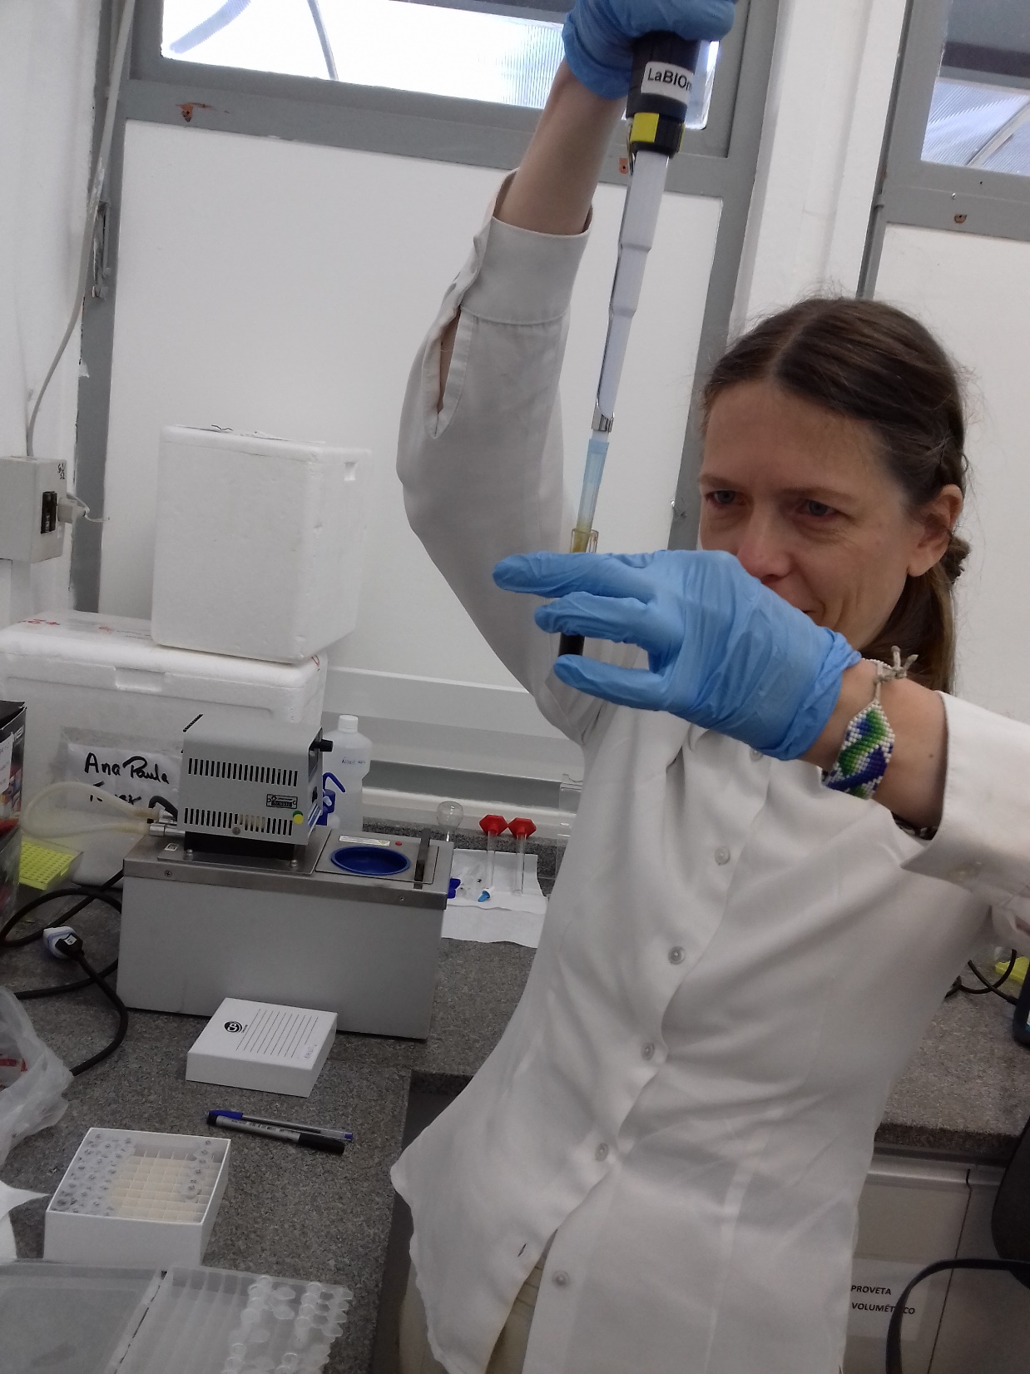

Slide 12
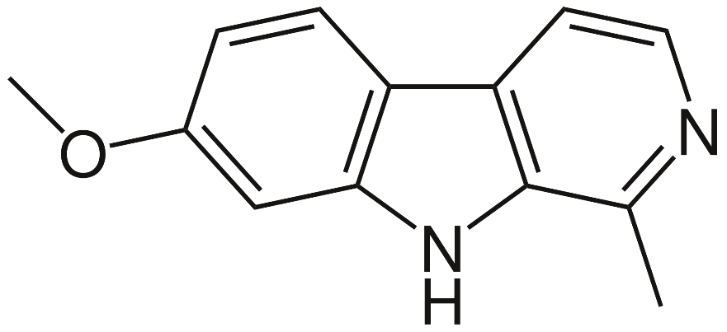
Chemical composition of ayahuasca
we determined concentrations of the 4 major active compounds
DMT tetrahydroharmine (THH) harmine (HME) harmaline (HML)
we detected additives / substitutes in some brews used at ayahuasca ceremonies

Slide 13
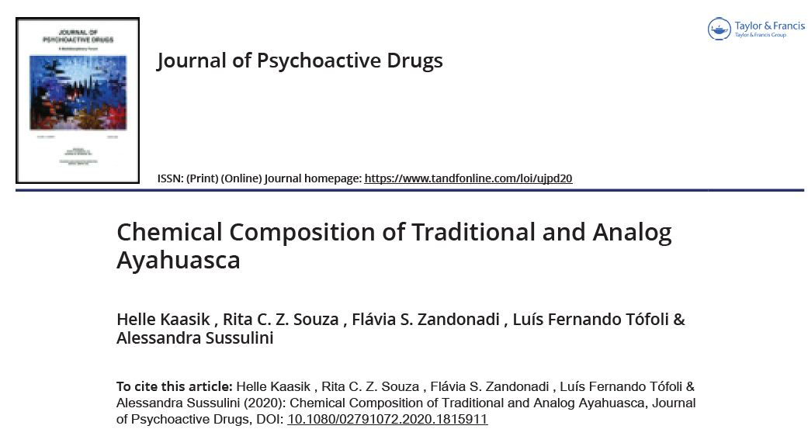

Slide 14
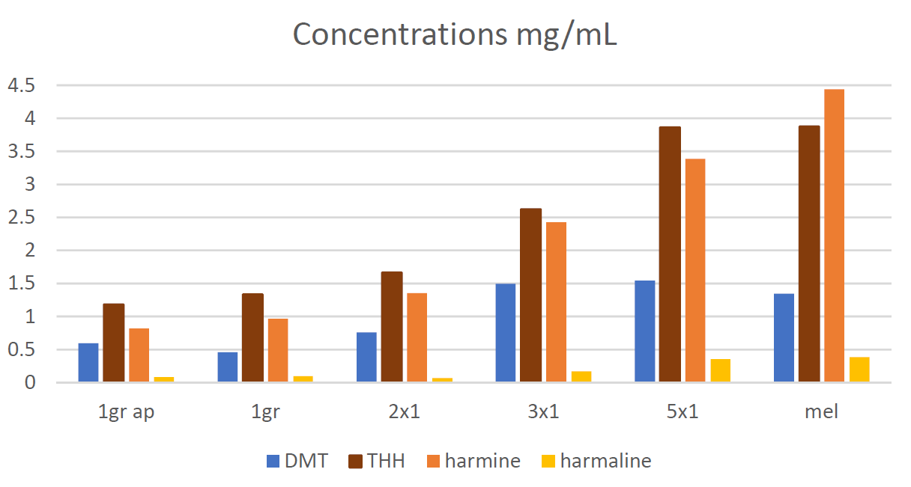

Slide 15
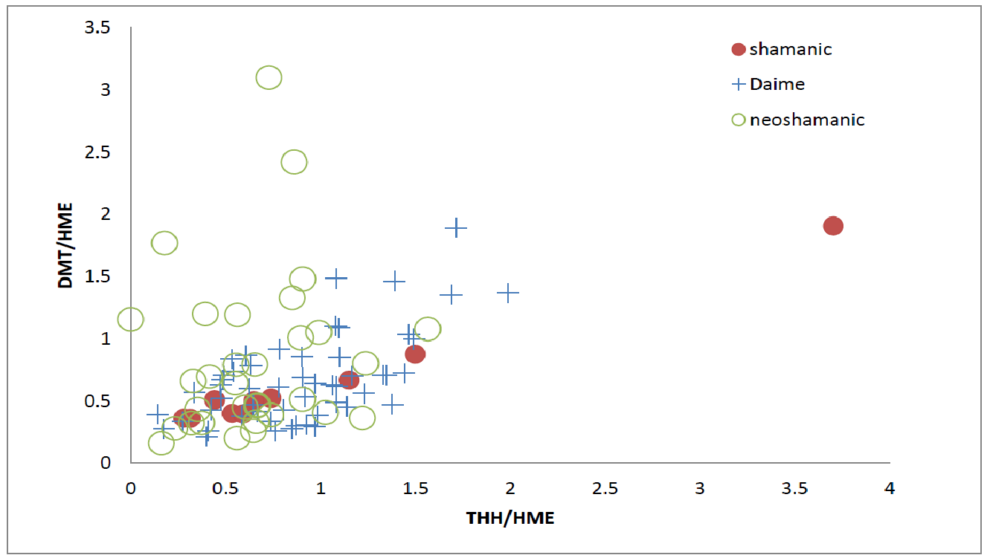
Results: DMT, THH, harmine by context

Slide 16
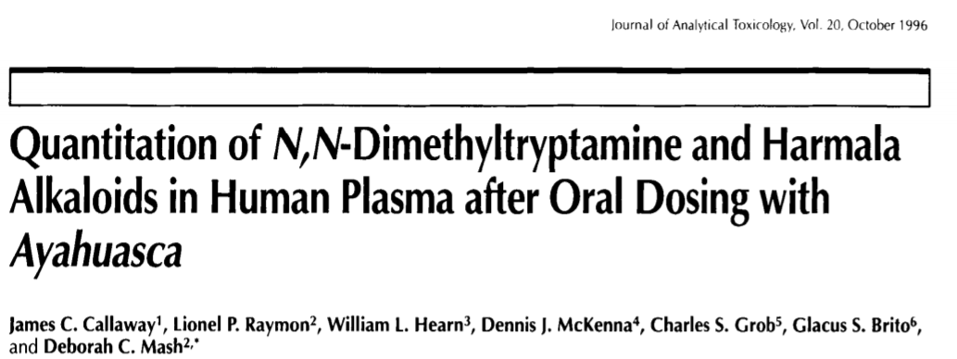
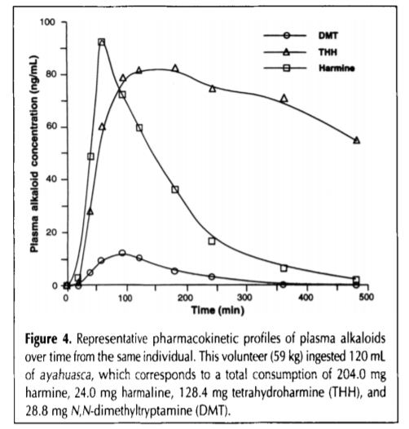
Tetrahydroharmine

Slide 17
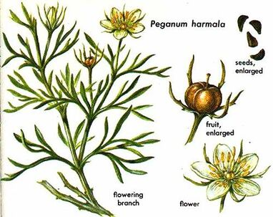
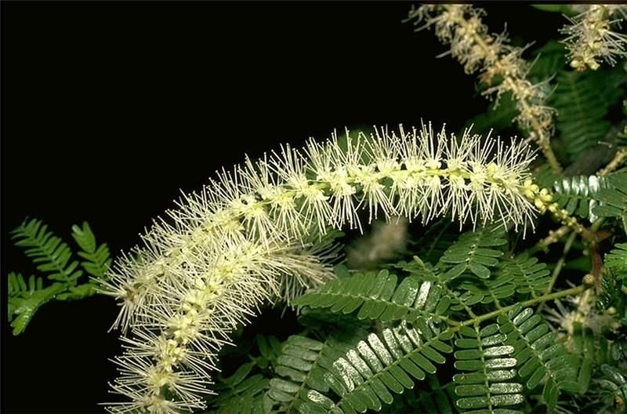
Ayahuasca analogues
Some use of analogue plants (Mimosa tenuiflora, Peganum harmala) in Europe was detected
Mimosa tenuiflora
http://colplanta.plantsoftheworld.online/taxon/urn:lsid:ipni.org:names:508775-1
https://www.white-buffalo-trading.com/rue-wild-syrian.html#/

Slide 18
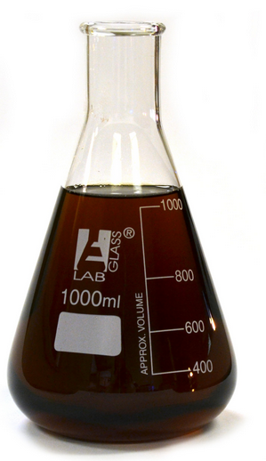
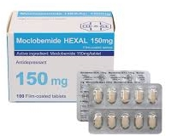
Fake ayahuasca
Psychonaut cocktails offered as ayahuasca in Europe:
very low concentrations of B. caapi alkaloids
moclobemide (pharmaceutical MAOI antidepressant)
psilocin
high concentrations of DMT from Mimosa tenuiflora

Slide 19
Conclusions
Variability: not one brew but many different
Awareness: know what you drink
Consent: psychonautic experimentation requires informed consent of the participants

Slide 20
Funding sources: EU Regional Development Fund: Dora+ 1.1 & 1.2, Kristjan Jaak Foundation Archimedes CWT Estonia / Kaleva Travel Fundação de Amparo à Pesquisa do Estado de São Paulo - FAPESP and INCT of Bioanalytics, Brazil Picture by Luis Tamani Amasifuen: https://inbarela.tumblr.com/post/79036272064/artist-luis-tamani-amasifuen

Slide 21
Big thanks to all the beings who helped me during the fieldwork, donated the samples and shared their wisdom and experience! Helle Kaasik helle.kaasik@ut.ee

