Slide 1
Formal Verification of
Quantum Cryptography
Dominique Unruh
University of Tartu

Slide 2
The trouble with security proofs
In theory:
Once a protocol is proven secure,
it is secure
In practice:
  Implementation is broken
  Proof is wrong
Computer-aided verification
to the rescue!

Slide 3
What is quantum cryptography?
Cryptography involving quantum mechanics
Post-quantum
crypto
Quantum
protocols

Slide 4
Quantum Protocols
Use quantum communication to make impossible tasks feasible
Best known example:
Unconditionally secure key distribution

Slide 5
Post-quantum cryptography
What must be done?
Identify assumptions that are not quantum-broken (e.g., lattice-based crypto, not RSA)
Build cryptosystems based on those
Prove security
Needs quantum know-how/ techniques
Possible
without
“quantum
literacy”?

Slide 6
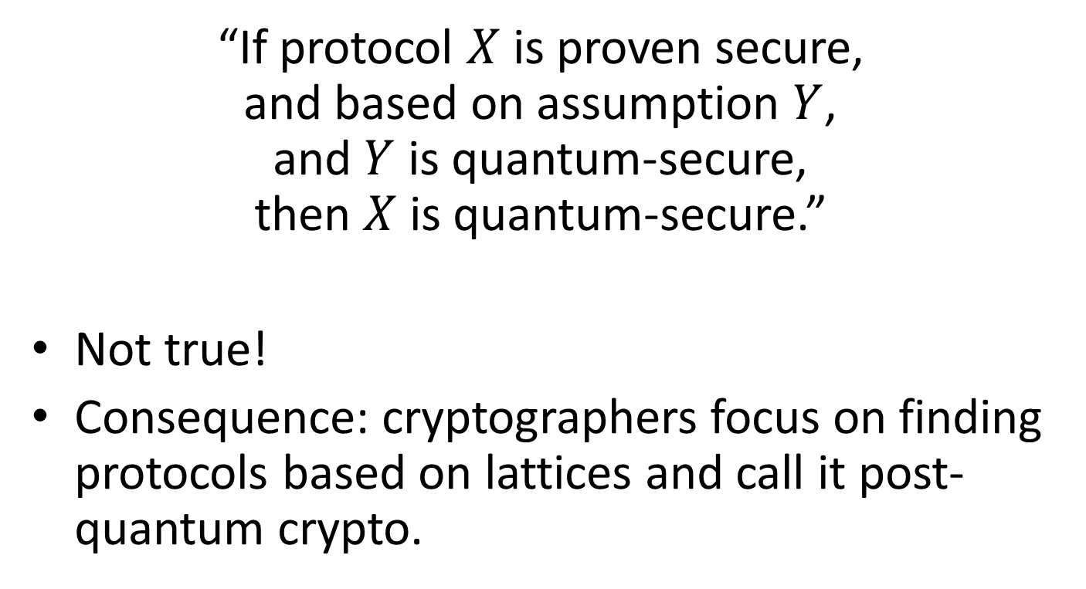
The post-quantum fallacy
“If protocol $X$ is proven secure,
and based on assumption $Y$,
and $Y$ is quantum-secure,
then $X$ is quantum-secure.”
Not true!
Consequence: cryptographers focus on finding protocols based on lattices and call it post-quantum crypto.

Slide 7
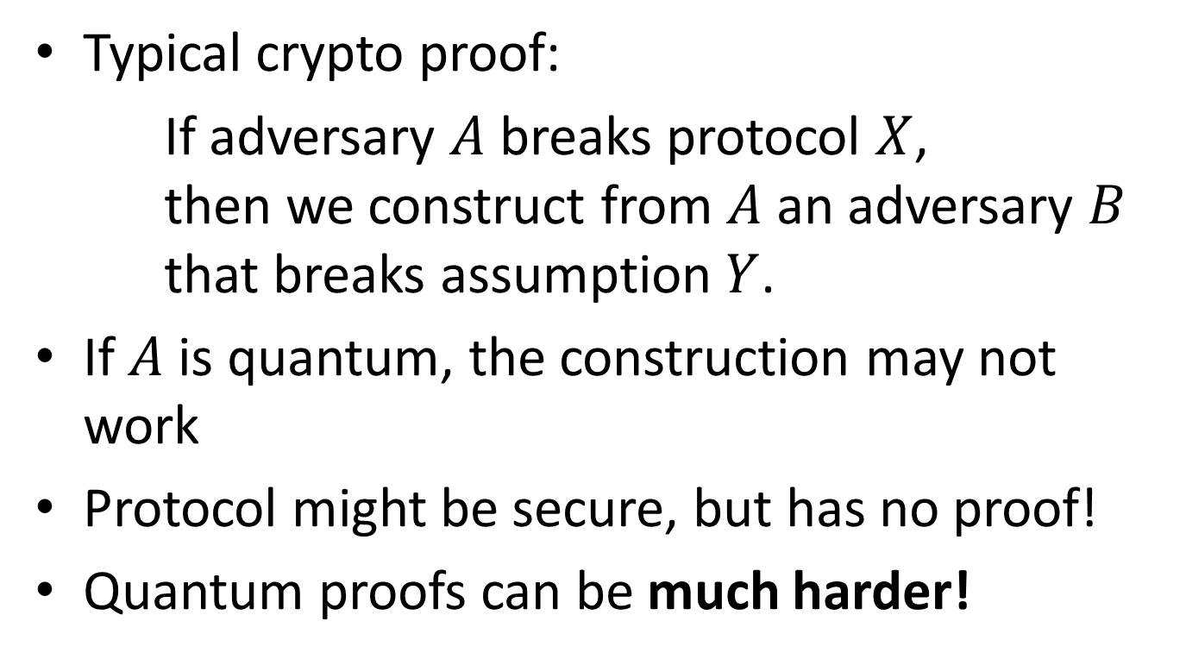
Why is the fallacy wrong?
Typical crypto proof:
If adversary $A$ breaks protocol $X$,
then we construct from $A$ an adversary $B$
that breaks assumption $Y$.
If $A$ is quantum, the construction may not work
Protocol might be secure, but has no proof!
Quantum proofs can be much harder!

Slide 8
Summary (so far)
Post-quantum crypto:
  Security of classical protocols against quantum attacks
Finding quantum hard assumptions:
Not enough
Need quantum proof techniques
➔ “Normal” cryptographers cannot verify their own schemes!

Slide 9
Quantum Crypto & Verification
Nothing to do (?)
Formal methods
& security
Symbolic models
Computational crypto
Post-quantum crypto
Quantum protocols
For classical protocols
For quantum protocols
“Classical” proofs
“Quantum” proofs
???
Existing tools?
New languages
and logics

Slide 10
Post-quantum crypto verification
(computational / classical proto / quantum adv)
Tools exist for computational verification
  CertiCrypt (relational Hoare)
  EasyCrypt (relational Hoare, higher level)
  CryptoVerif (rewriting, automated)
Could those be quantum-sound?

Slide 11

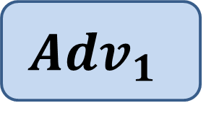


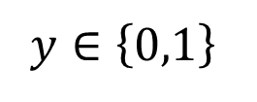
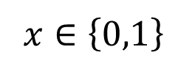
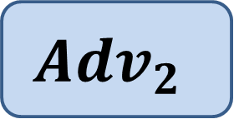
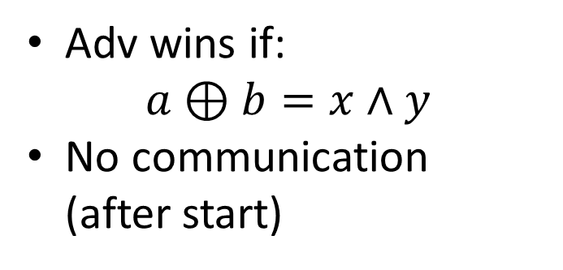
Quantum soundness of EasyCrypt
CHSH game:
EasyCrypt proof: $\operatorname{Pr}\left[win\right]≤0.75$
Quantum strategy: $\operatorname{Pr}\left[win\right]≈0.85$
$$x∈\left\{0,1\right\}$$
$$y∈\left\{0,1\right\}$$
Adv wins if:
$a⊕b=x∧y$
No communication
(after start)
$${Adv}_{1}$$
$$Adv_{2}$$
$$a$$
$$b$$

Slide 12
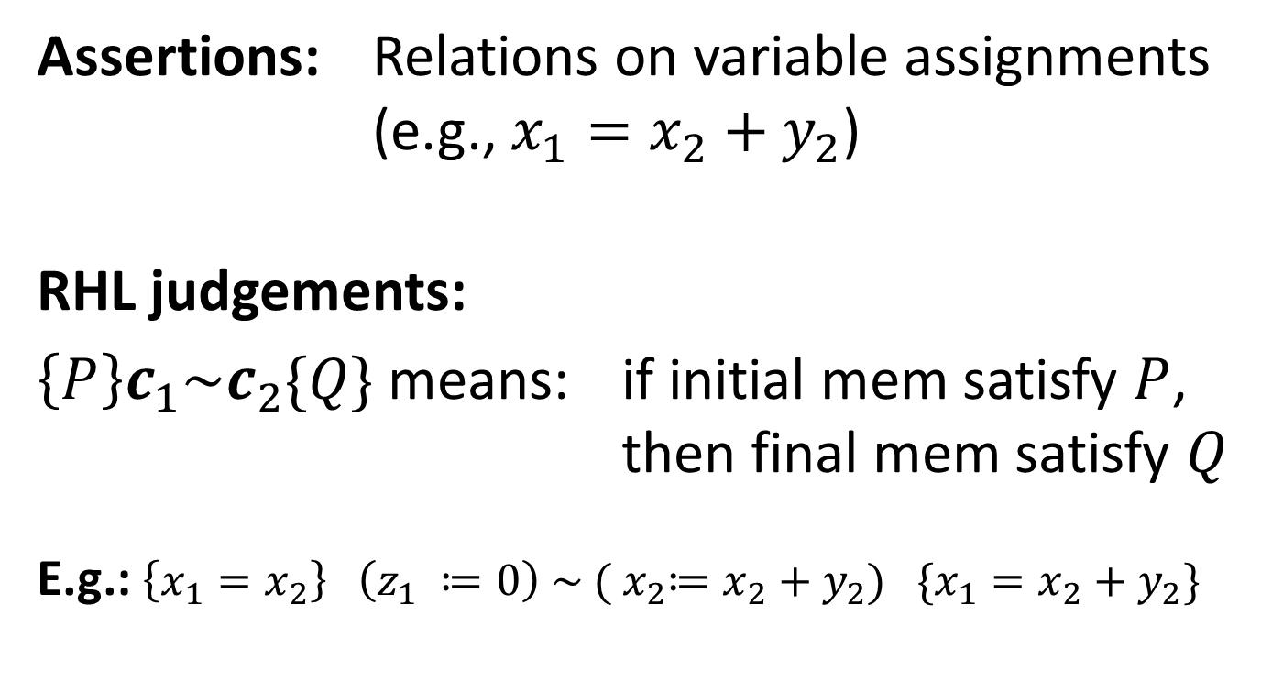
How EC works: Relational Hoare Logic
Enables: step-by-step proof that two “games” are equivalent
A.k.a. “game-based proofs”
Assertions: Relations on variable assignments
(e.g., $x_{1}=x_{2}+y_{2}$)
RHL judgements:
$\left\{P\right\}c_{1}\sim c_{2}\{Q\}$ means: if initial mem satisfy $P$,
then final mem satisfy $Q$
E.g.: $\left\{x_{1}=x_{2}\right\} \left(z_{1} ≔0\right) \sim ({ x}_{2}≔x_{2}+y_{2}) \{x_{1}=x_{2}+y_{2}\}$

Slide 13
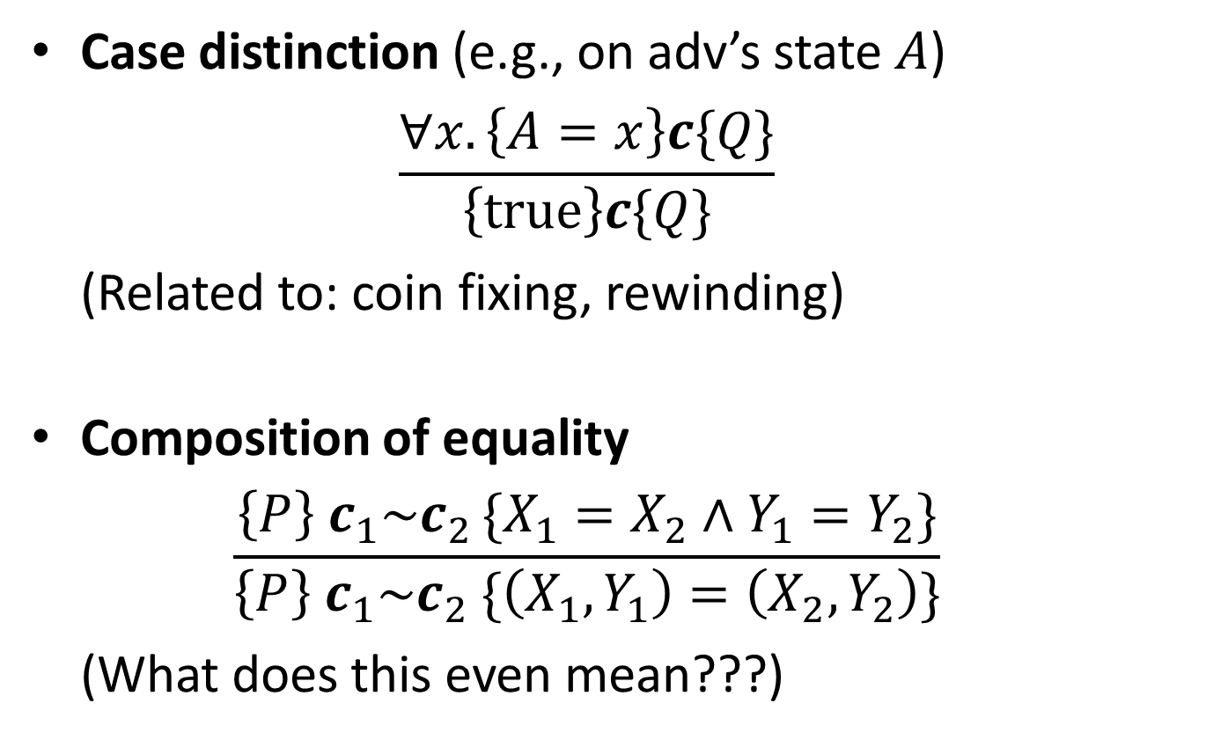
Why EasyCrypt fails…
Case distinction (e.g., on adv’s state $A$)
$\frac{∀x. \left\{A=x\right\}c\{Q\}}{\left\{true\right\}c\{Q\}}$
(Related to: coin fixing, rewinding)
Composition of equality
$\frac{\left\{P\right\}{ c}_{1}\sim c_{2 }\{X_{1}=X_{2}∧Y_{1}=Y_{2}\}}{\left\{P\right\}{ c}_{1}\sim c_{2} \{\left(X_{1},Y_{1}\right)=\left(X_{2},Y_{2}\right)\}}$
(What does this even mean???)

Slide 14
“QuEasyCrypt” (ongong work…)
Quantum language for crypto games
  Follows EasyCrypt, no surprises
Quantum Hoare Logic
Quantum Relational Hoare Logic
  Same intuition as probabilistic RHL
  But semantics are quantum
  → rules must be refined

Slide 15
Challenges
If defining quantum RHL analogous to classical:
  No “frame rule” – judgements are not preserved when adding environment
  No sensible notion of equality of variables
More info offline if interested

Slide 16
QuEasyCrypt – the future
If you can use EasyCrypt, you can use QuEasyCrypt
  Get post-quantum verification for free
  (when classical proof is quantum-sound)
Verification of quantum protocols:
  Should be possible
  Time will show

Slide 17
Summary
Nothing to do (?)
Formal methods
& security
Symbolic models
Computational crypto
Post-quantum crypto
Quantum protocols
For classical protocols
For quantum protocols
“Classical” proofs
“Quantum” proofs
???
Existing tools?
New languages
and logics
QuEasyCrypt?

Slide 18






I thank for your
attention
Logo
soup
This research was supported by European Social Fund’s Doctoral Studies and Internationalisation Programme DoRa

